Slide 1

Introduction To Programming Final Project
James Aubry
8/24/2023

Slide 2
INTRODUCTION
Computer programming is the process of designing, writing, testing, and maintaining sequences of instructions (code) that a computer can execute to perform specific tasks.
Programming is at the heart of software development, enabling us to create a wide range of applications, from simple scripts to complex software systems.

Slide 3

CEIS110
Module 2
Design and setup
Student: James Aubry

Slide 4

Rubric
Develop Flowchart
Take a screen shot of the Python program

Slide 5
Flowchart
Start
Run a basic python program
Include the following processes:
  Run a basic python program
  Download weather data to a database.
  Query the weather data
  Extract weather data from database into a comma separated file with python
  Cleanse weather data
  Use python data analytics modules to develop graphical models
Download weather data to a database
Query the weather data
Extract weather data from database into a comma separated file with python
Cleanse weather data
Use python data analytics modules to develop graphical models
End

Slide 6
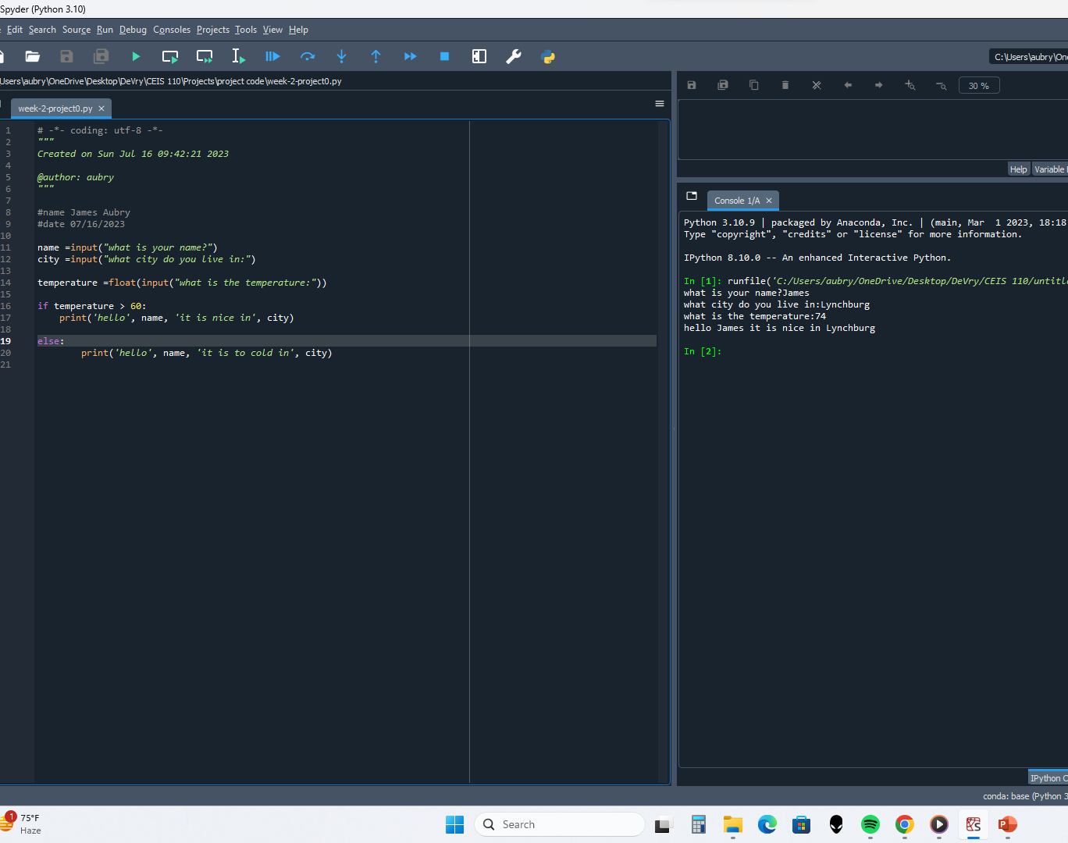
Python program (Screenshot)
Include screenshot of successful python program

Slide 7
CEIS110
Module 3
Downloading weather data
Student: James Aubry

Slide 8
Rubric
Screenshot of code in Spyder with your name, date, and zip code
Screenshot of Python console showing program ran successfully
Screenshot from Windows Explorer showing database file was created

Slide 9
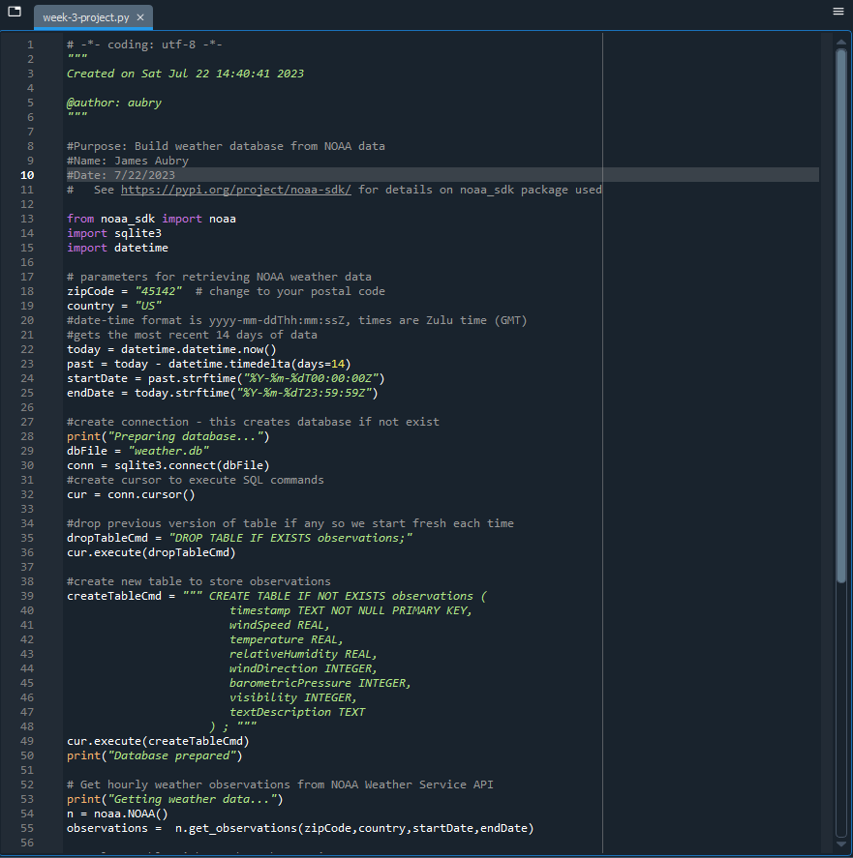
BuildWeatherDb.py Code (Screenshot)
Screenshot of code in Spyder
Must have your name and date in comments
Must have your zip code

Slide 10
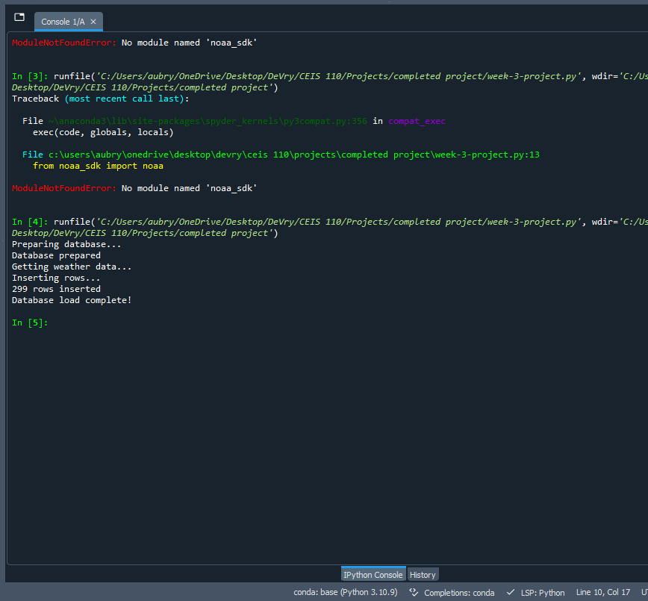
Python Console
(Screenshot)
Screenshot of program output in Python console showing program executed successfully

Slide 11
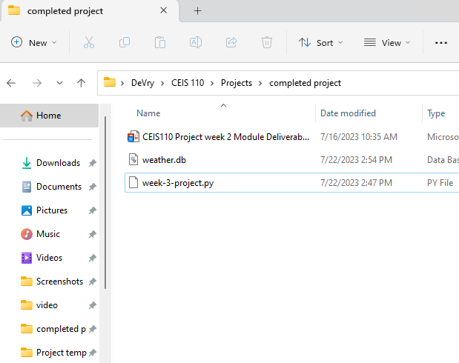
Weather.db File
(Screenshot)
Screenshot of Windows Explorer showing database file Weather.db was created

Slide 12
CEIS110
Module 4
Querying the database with SQL
Student: James Aubry

Slide 13
Rubric
Query to retrieve all columns and rows
Query to retrieve lowest and highest temperature
Query to find all Clear days

Slide 14
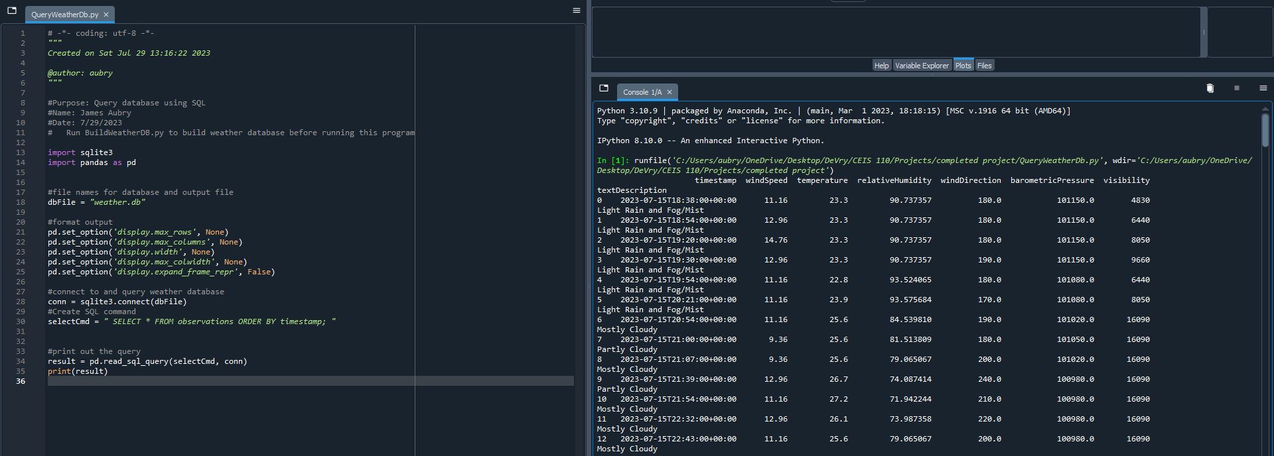
Query to retrieve all columns and all rows (Screenshot)
Screenshot of SQL query command and results

Slide 15
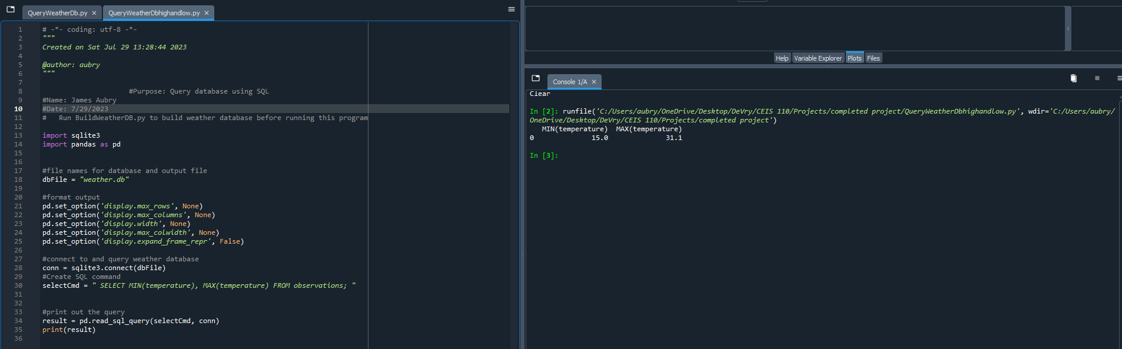
Query to retrieve lowest and highest temperatures
(Screenshot)
Screenshot of SQL query command and results

Slide 16
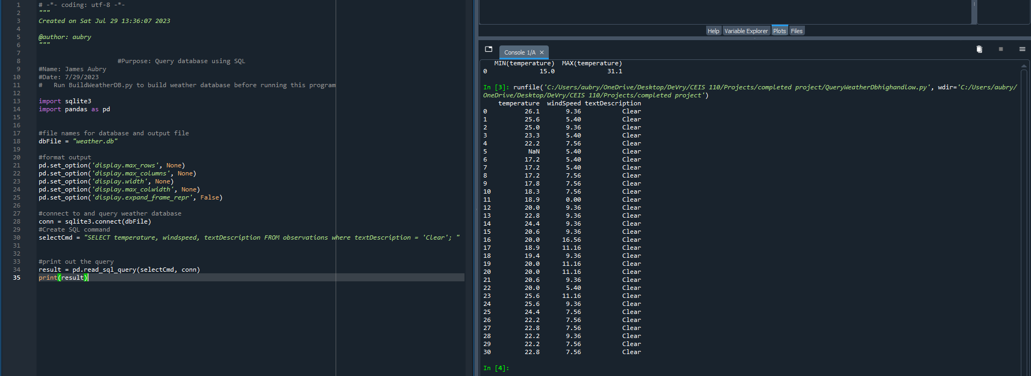
Query to retrieve all clear days
(Screenshot)
Screenshot of SQL query command and results

Slide 17
CEIS110
Module 5
Querying and manipulating data with SQL and Python
Student: James Aubry

Slide 18
Rubric
Screenshot of code
Screenshot of data in Excel file
Chart of data from database

Slide 19
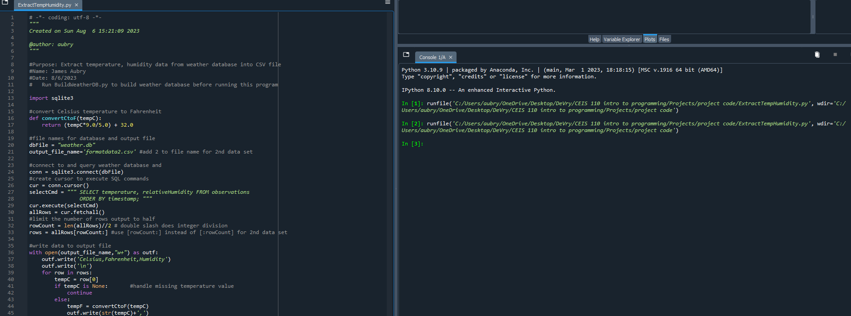
Python code (Screenshot or file)
ExtractTempHumidity.py Python code with your name and date in comments

Slide 20
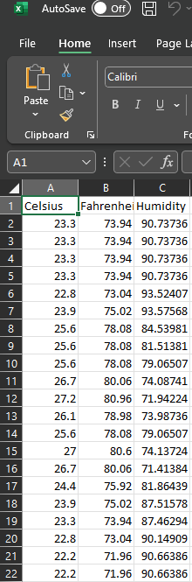
Retrieve and Convert Data to CSV Format (Screenshot)
Formatdata file open in Excel showing 3 columns of data

Slide 21
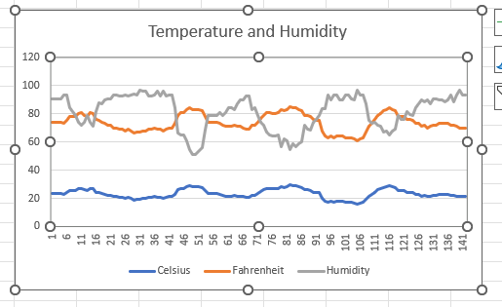
Temperature and Humidity Chart
(Graph)
Excel chart based on temperature and humidity data from database

Slide 22
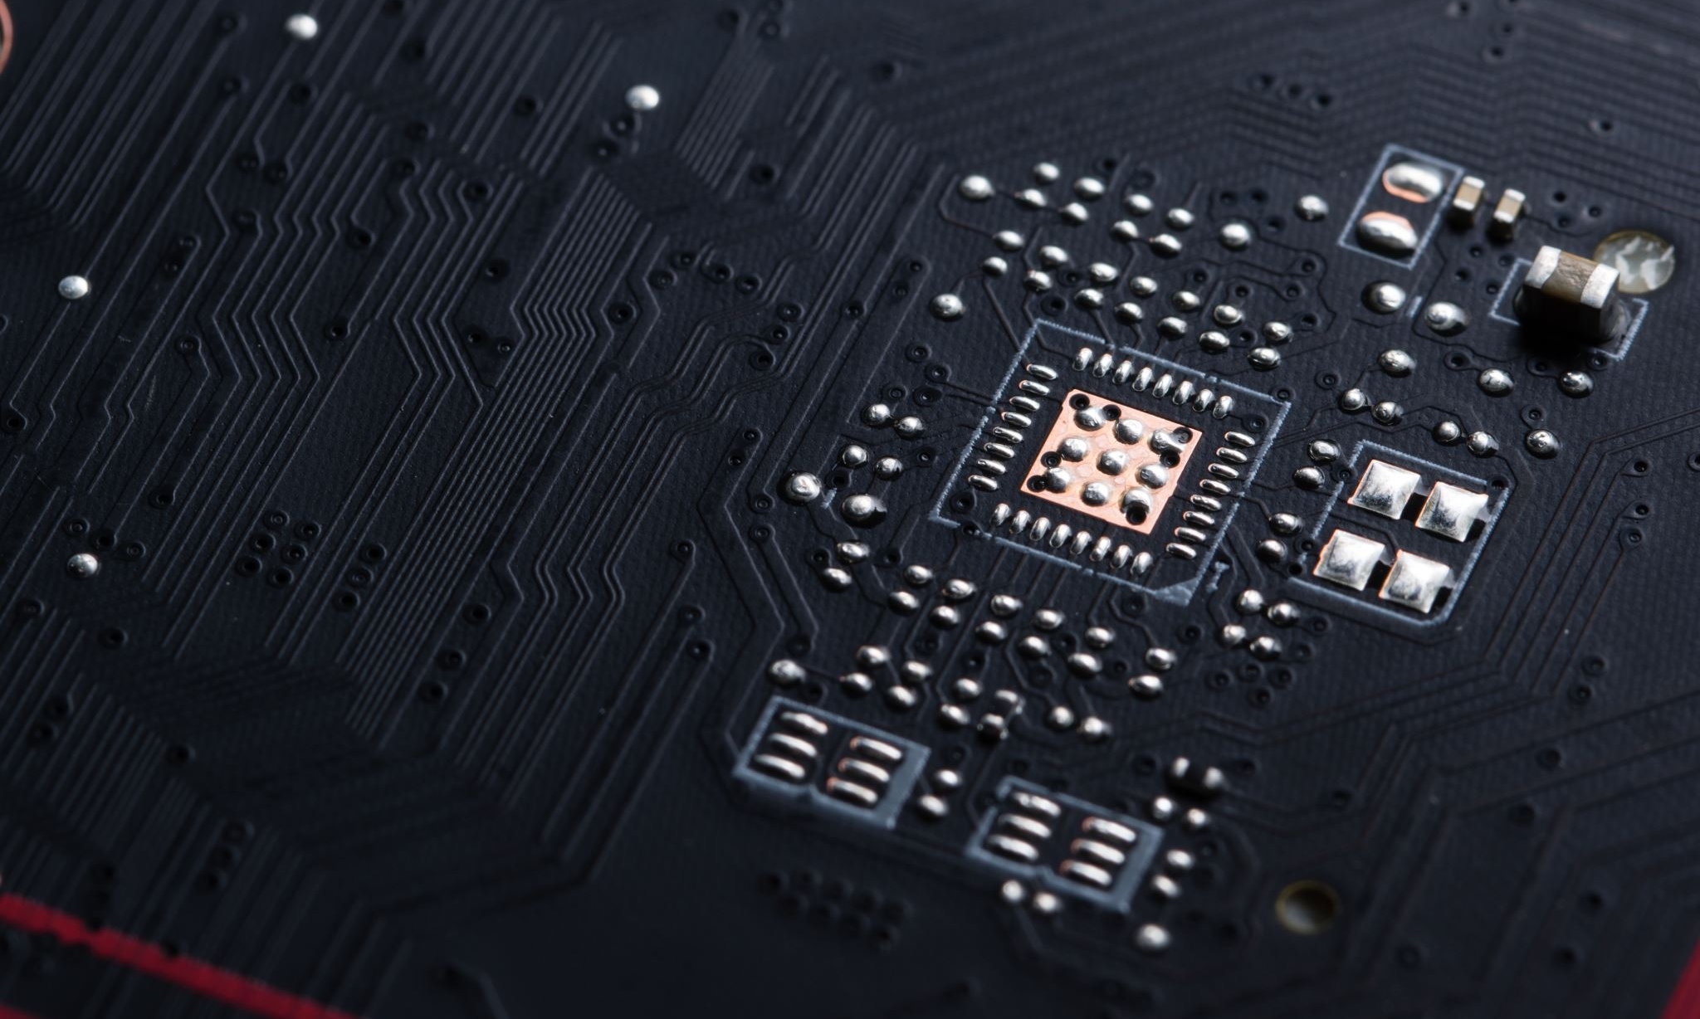
CEIS110
Module 6
Develop Graphical Models and Interpret Results
Student: James Aubry

Slide 23
Rubric
Picture/screenshot of plot from data with code
Picture/screenshot of plot from data with code
Question, plot, and answer
Prediction based on data

Slide 24
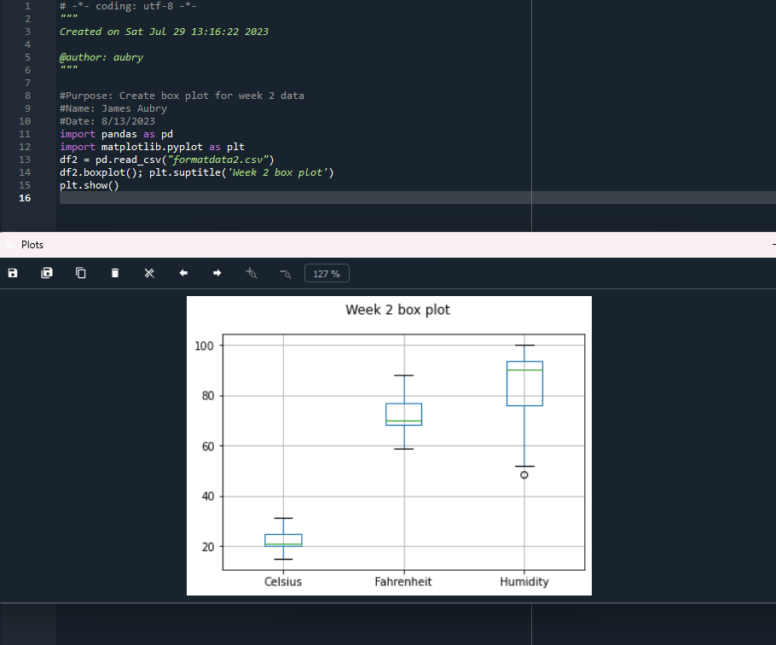
Plot #1
Plot and code used to generate it
Box
Line
Histogram
Scatter
Research your own!

Slide 25
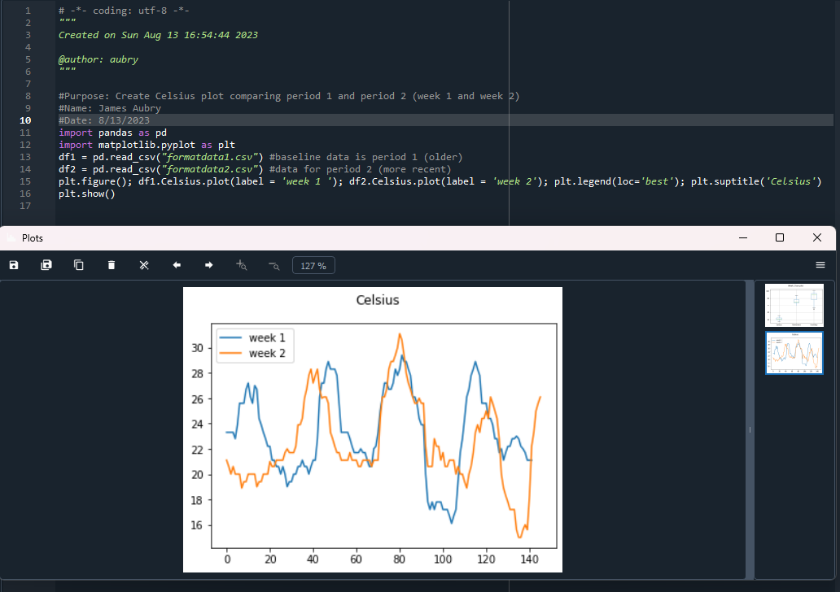
Plot #2
(Screenshots)
Plot and code used to generate it
Box
Line
Histogram
Scatter
Research your own!

Slide 26
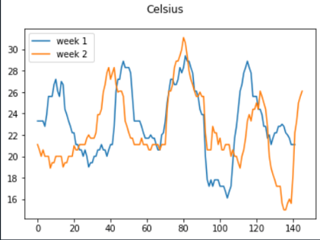
Analysis
Think of your own question and create a chart/graph to answer it
Your own question: was week one or week to warmer?
Answer supported by Chart: week 2

Slide 27

Prediction
Develop a prediction based on the data. What variations in temperature and humidity do you expect over the next few hours or days? How would humidity change if temperature goes up or down?
I predict the temperature and humidity will get warmer over the next few days. I believe from the chart the warmer it was getting the higher the humidity was.

Slide 28
CHALLENGES
Python is case sensitive
Missed a lot of spaces between code and just little characters you need to pay close attention to

Slide 29
CAREER SKILLS
A career in computer programming requires a combination of technical skills, problem-solving abilities, and soft skills to excel and thrive in the rapidly evolving tech industry. Here are some essential skills for a successful career in computer programming:
Programming Languages: Proficiency in one or more programming languages is fundamental. Depending on your area of interest, languages like Python, Java, JavaScript, C++, Ruby, and others might be relevant.
Problem-Solving: Programming is about solving complex problems. The ability to break down problems into smaller, manageable components and devise effective solutions is crucial.
Algorithmic Thinking: Understanding and implementing algorithms efficiently is at the core of programming. This involves selecting appropriate data structures and designing algorithms for optimal performance.
Data Structures: A strong grasp of data structures (arrays, linked lists, stacks, queues, trees, graphs, etc.) is vital for efficient data manipulation and optimization.

Slide 30
CONCLUSION
Computer programming is a dynamic and creative endeavor that empowers individuals to interact with technology in profound ways. Through the mastery of programming languages, syntax, algorithms, and problem-solving techniques, programmers gain the ability to translate their ideas into functional software solutions. This skill has transformed industries, enabling the development of everything from simple scripts to complex applications that shape our modern world.

