Slide 1

Linux Final Presentation
JAMES AUBRY
6/21/2023

Slide 2

INTRODUCTION
Linux is one of the most popular operating systems for corporate servers.
Linux administration can be utilized using the GUI
Linux is one of the better operating systems used

Slide 3

LINUX FILE SYSTEM
Navigating the Linux filesystem tree
Creating directories and files
Copying and removing directories and files
Locating directories and files

Slide 4
Navigate the Linux filesystem tree
1. What is the pwd command an acronym for? What about the cd command?
Answer here:
*PWD- print work directory
*cd- change directory
2. Explain the differences between a relative path and an absolute/full path in Linux.
Answer here:
A relative path is a path that is specified relative to the current working directory of the user or application. For example, if the current working directory is /home/user/documents/ and you want to refer to a file called report.txt in the same directory, you can use the relative path report.txt. If you want to refer to a file in a directory that is one level up from the current working directory, you can use the relative path ../filename. The .. notation represents the parent directory.
An absolute/full path is a path that specifies the location of a file or directory starting from the root of the file system. It provides a complete path that can be used to identify a file or directory from any location on the file system. For example, if the file you want to refer to is located at /home/user/documents/report.txt, you can use the absolute path /home/user/documents/report.txt.
The main difference between the two paths is that a relative path is specified relative to the current working directory, while an absolute path is specified relative to the root of the file system. Absolute paths provide a complete path that can be used to identify a file or directory from any location on the file system, while relative paths are more convenient to use when referring to files or directories within the same directory or subdirectory.

Slide 5
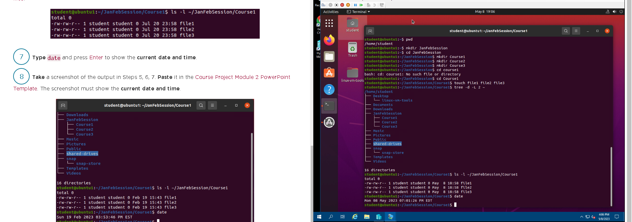
Create directories and files

Slide 6
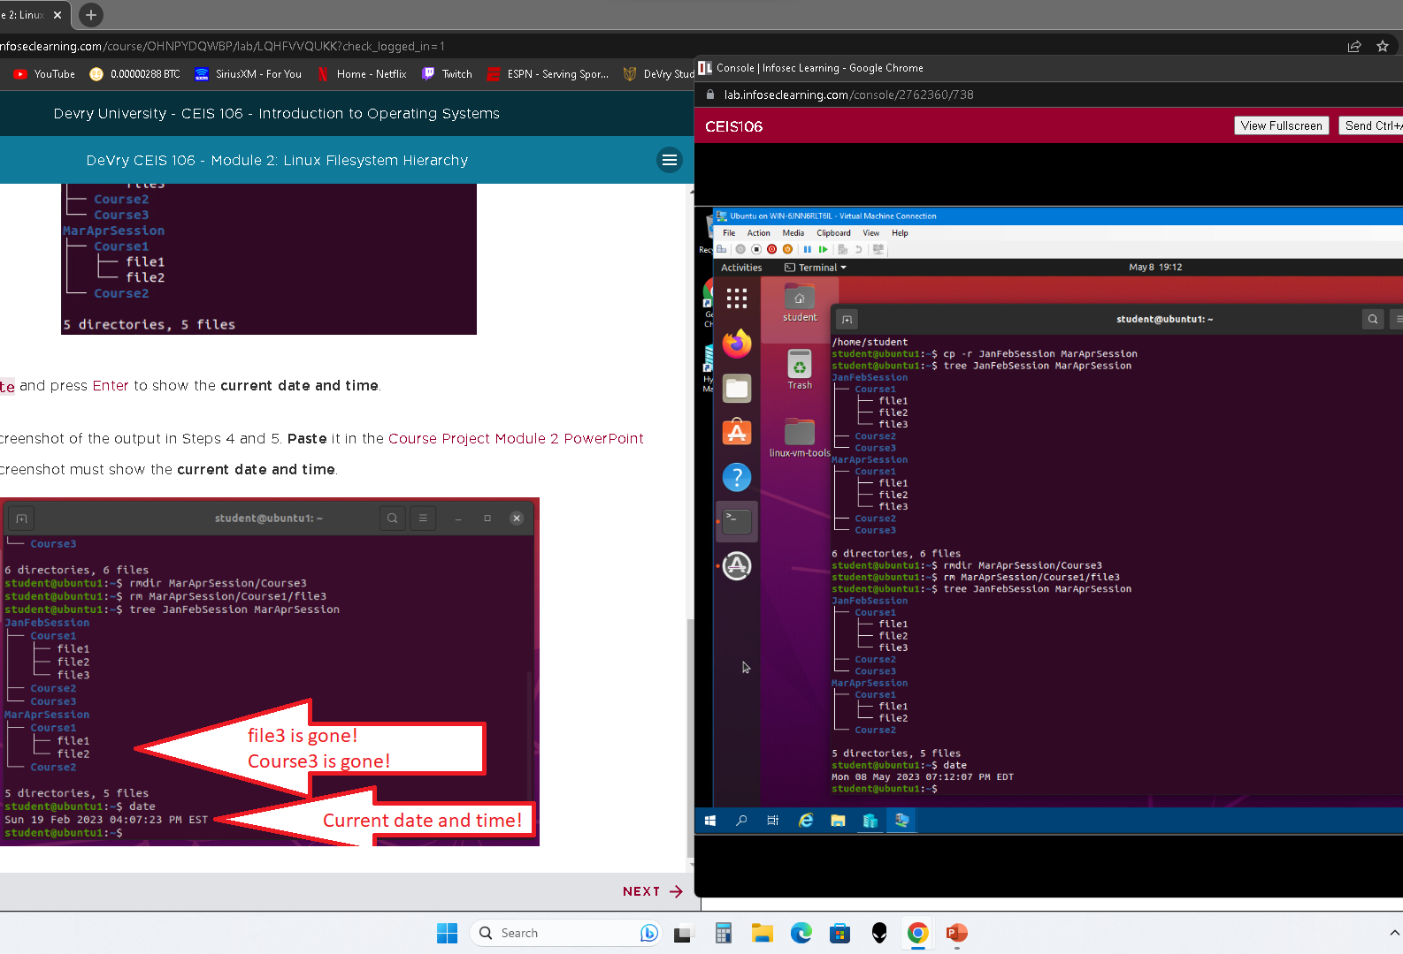
Copy and remove directories and files

Slide 7
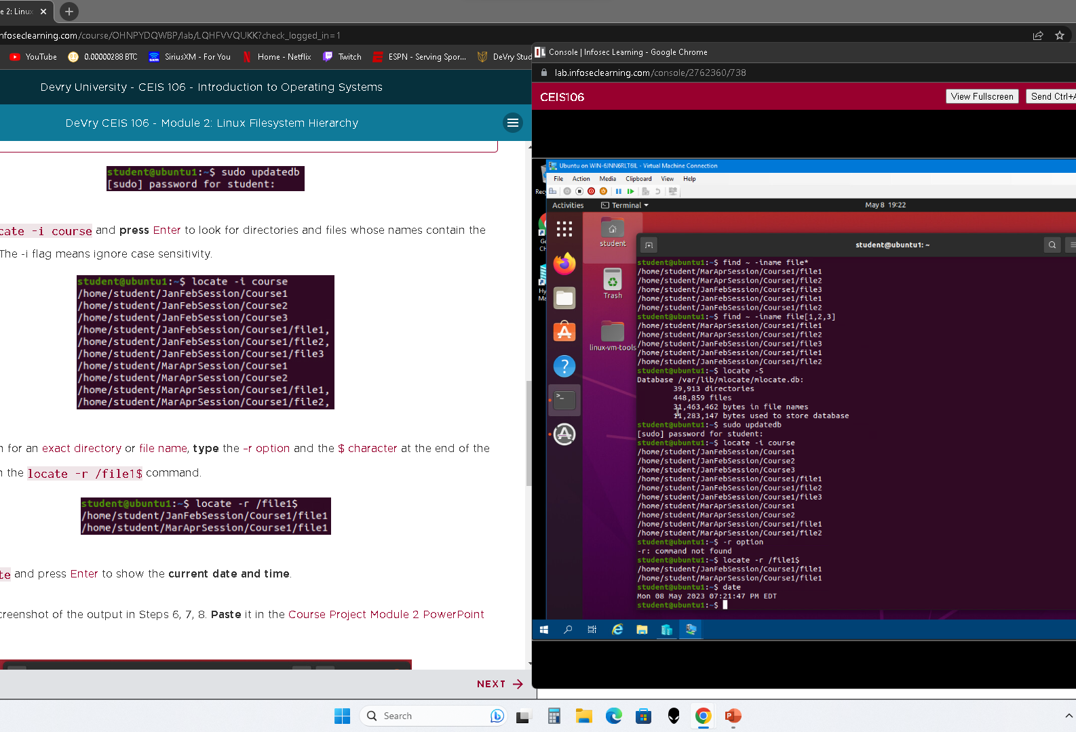
Locate directories and files

Slide 8
Linux Shell Scripts
Create a shell script
Change permissions to a script file
Set PATH variable
Made PATH variable permanent

Slide 9
Create a shell script
1. What are the file permissions of the script?
Answer here:
-rw-rw-r--
2. What’s the name of the user-defined variable in the script?
Answer here:
text
3. Which redirection meta-character is used in the script? What does it do?
Answer here:
>> --append the output to the end of the file and retain the content of the file

Slide 10
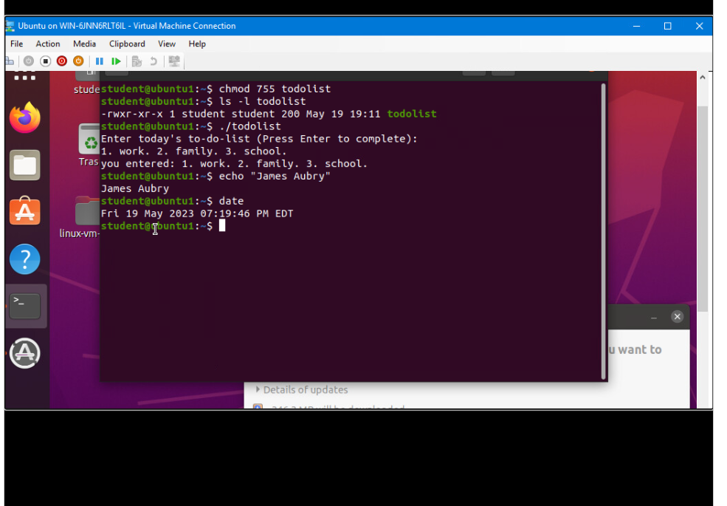
Change script file permissions

Slide 11
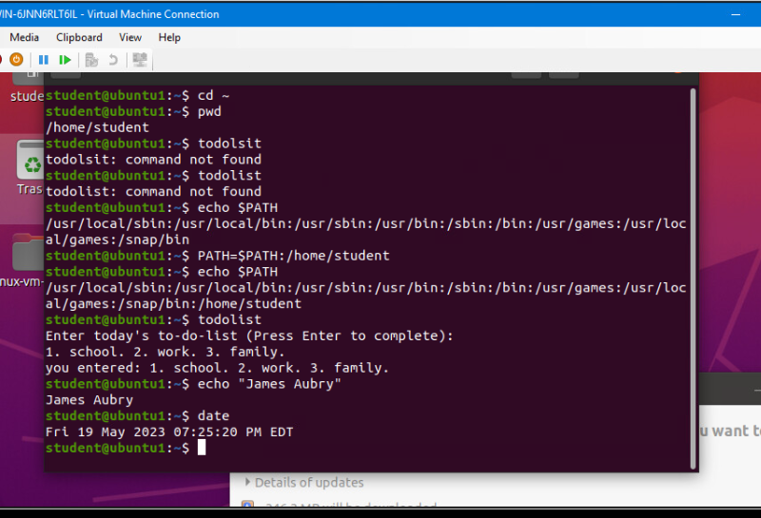
Set the PATH variable

Slide 12
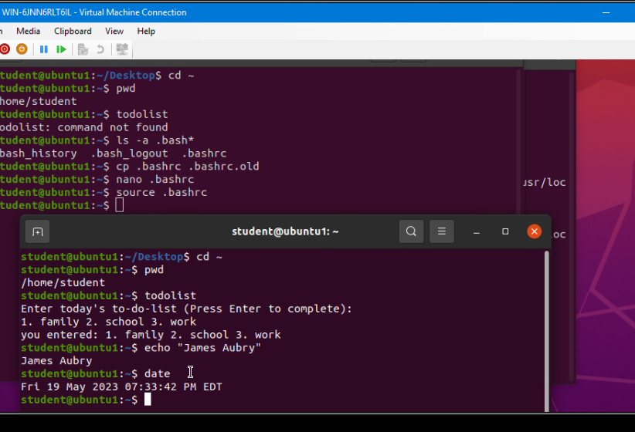
Make the PATH variable permanent

Slide 13
User and group management
Add users and groups in CLI
Test user and group settings
Add users in GUI
Remove users and groups

Slide 14
Add users and groups in CLI
1. What does the –m option in the useradd command do?
Answer here:
-m tells Linux to create a home directory for this new account
2. What does the -3 option in the tail command do?
Answer here:
-3 tells tail command to show only three lines
3. Which line of the /etc/group file lists members of the “students” group? Copy it here.
Answer here:

Slide 15
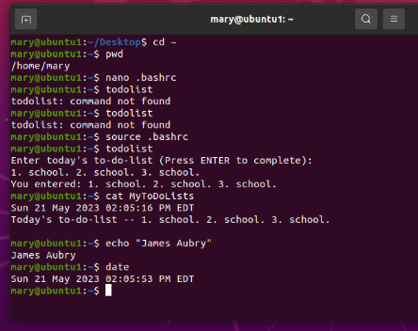
Test user and group settings

Slide 16
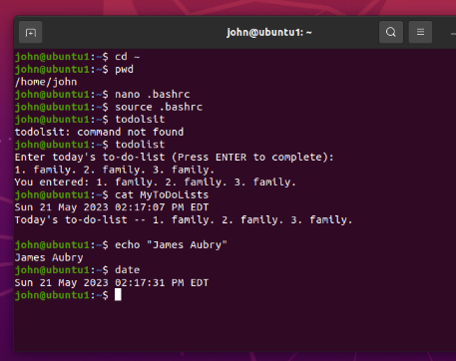
Add users in GUI

Slide 17
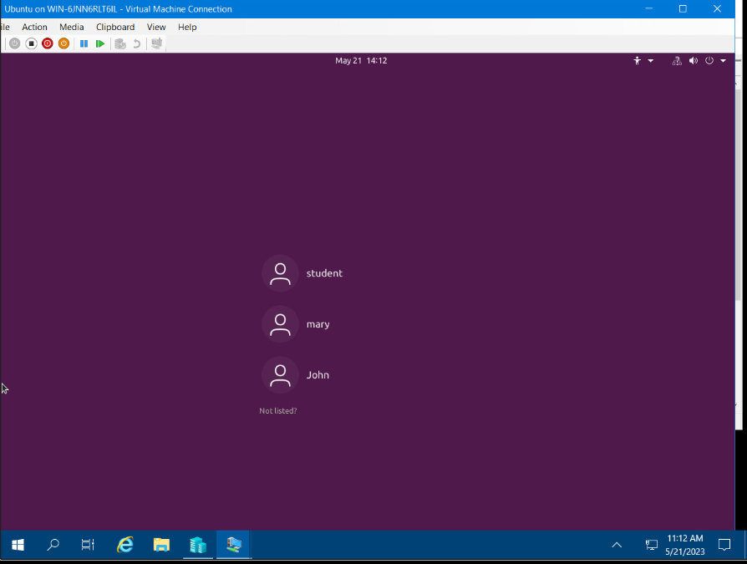
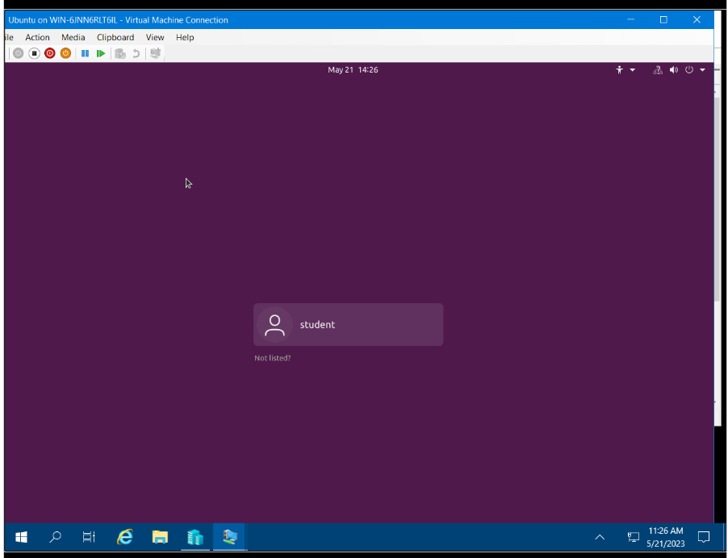
Remove users and groups

Slide 18
Network configuration
Discover host IP configurations
Manage network interfaces
User network utilities

Slide 19
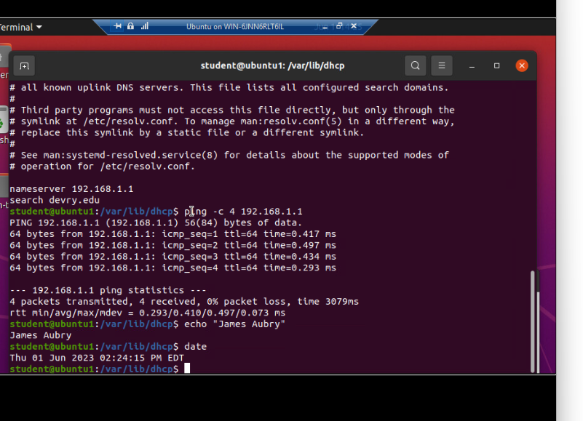
Discover host IP configurations
1. What is the IP address of your Ubuntu machine?
Answer here: 192.168.1.107
2. What is the IP address of its default gateway?
Answer here: 192.168.1.1
3. What is the IP address of its DHCP server?
Answer here:192.168.1.1
4. What is the IP address of its DNS server?
Answer here:192.168.1.1

Slide 20
Manage network interfaces
1. Which DHCP message is shown in the output of the sudo dhclient –v –r ens33 command?
Answer here: DHCPRELEASE
2. Which four DHCP messages are shown in the output of the sudo dhclient –v ens33 command?
Answer here:
DHCPDISCOVER
DHCPOFFER
DHCPREQUEST
DHCPACK

Slide 21
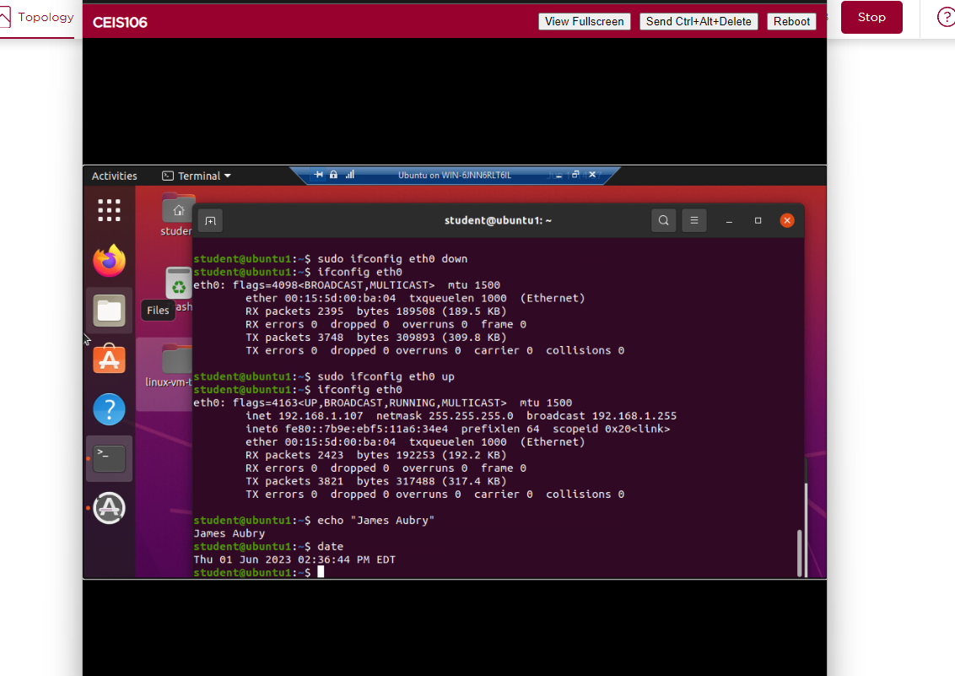
Use network utilities

Slide 22
System performance monitoring
Monitor processes
Monitor user activities
Monitor network bandwidth usage

Slide 23
Monitor Linux processes
1. What is the default action of the 15 SIGTERM kill signal?
Answer here: It terminates the selected process
2. In the System Monitor window, click on % CPU to sort the processes by CPU load. Which process shows the highest percentage of CPU usage?
Answer here: : It is gnome-shell of Ubuntu Kernel

Slide 24

Monitor user activities
Issue the sudo accton on command to turn on GNC accounting. Run the sudo updatedb command. Enter lastcomm updatedb to check if the updatedb command was executed before. Remember to turn off GNC accounting (sudo accton off) after answering the questions.
1. What flag value is displayed in the output?
Answer here: The flag value is s
2. Why is the name of the user who ran the processes shown as root, not student?
Answer here: The root user under Linux is the superuser (Admin)

Slide 25
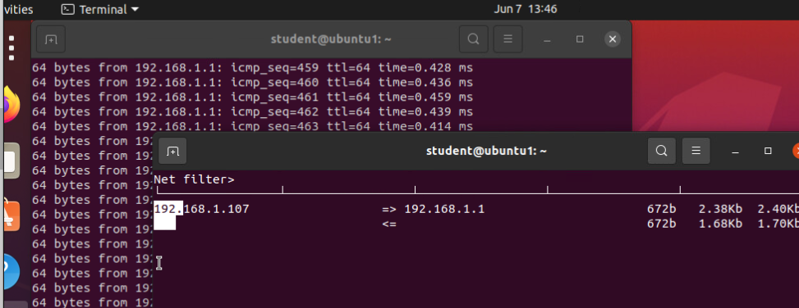
Monitor network bandwidth usage

Slide 26
Challenges
Linux is case sensitive
Several times I thought lowercase l was a capital I or the number 1

Slide 27
Career skills
Writing scripts
Managing users and groups on Linux
Learning Linux to set up corporate servers

Slide 28
Conclusion
Linux is fun to learn
Linux is similar to windows
Excited to start a career involving Linux

