Slide 1
CEIS101C COURSE PROJECT SMARTHOME AUTOMATION AND SECURITY SYSTEM
Presented by: James Aubry

Slide 2

Introduction
Develop a smart home automation and security system by
-Designing the prototype in Tinkercad
-Building the hardware with Tech Core Kit
-Programming with Arduino IDE
The smart home system will encompass various devices to monitor the condition of the home.
-Door sensor to check whether the door is open or closed
-Distance sensor to monitor for a possible home intruder
-Automated lights that turn on when it is dark

Slide 3
CEIS101
Module 2
Circuit Simulation in Tinkercad

Slide 4
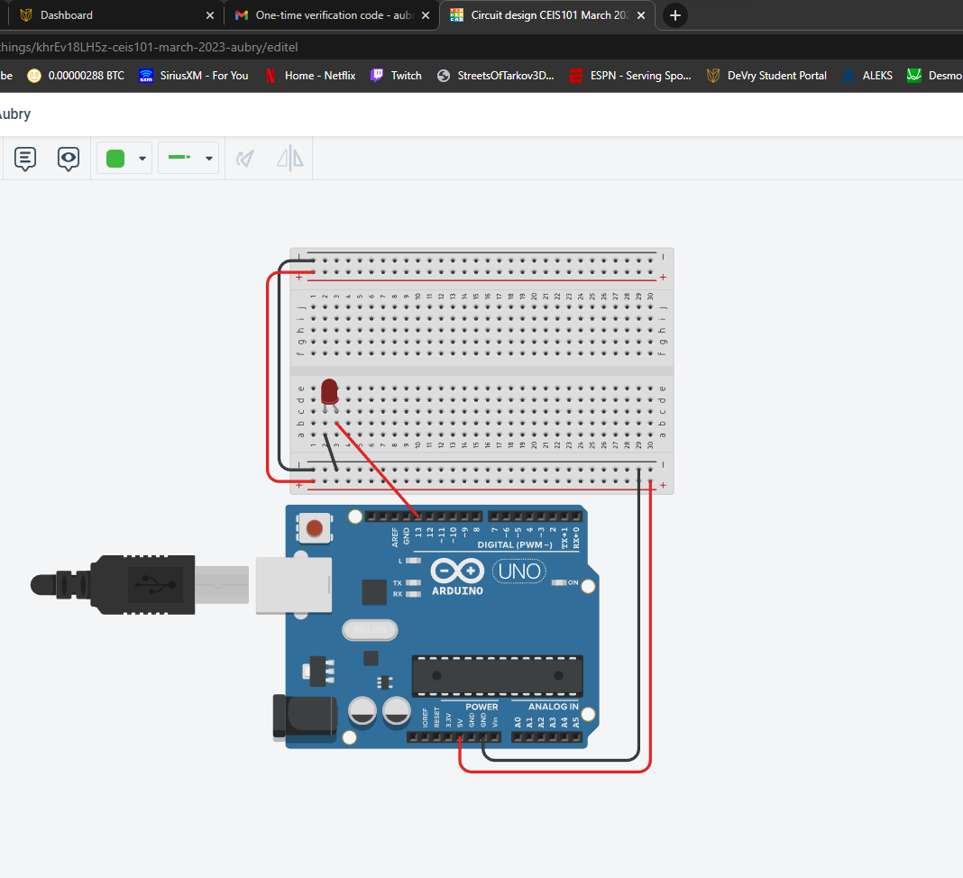
Circuit (screenshot)

Slide 5
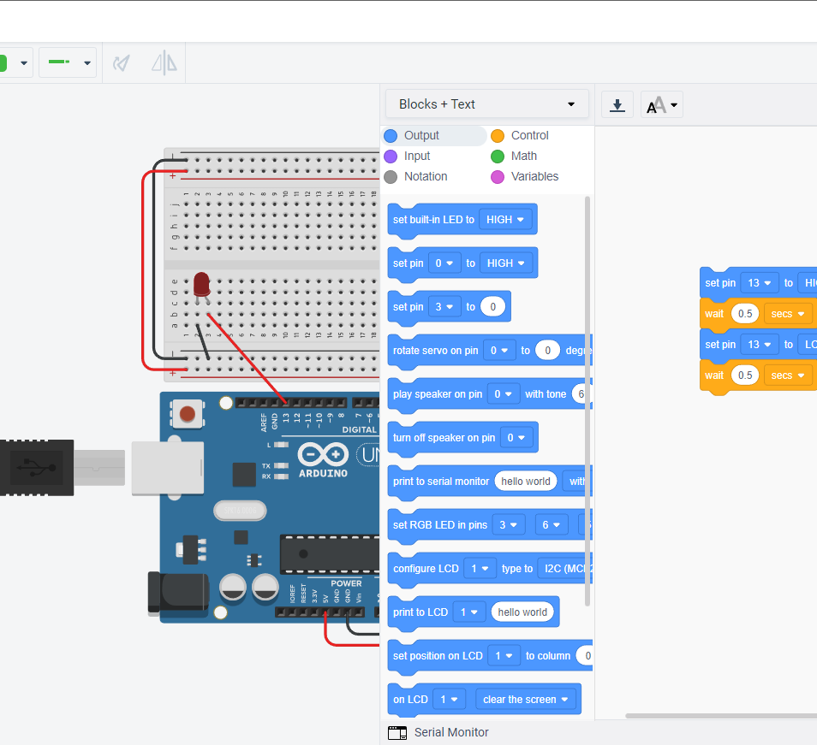
Code (screenshot)

Slide 6
CEIS101
Module 3
Inventory of Parts, Circuit Building, and Displaying Messages
Student: James Aubry

Slide 7
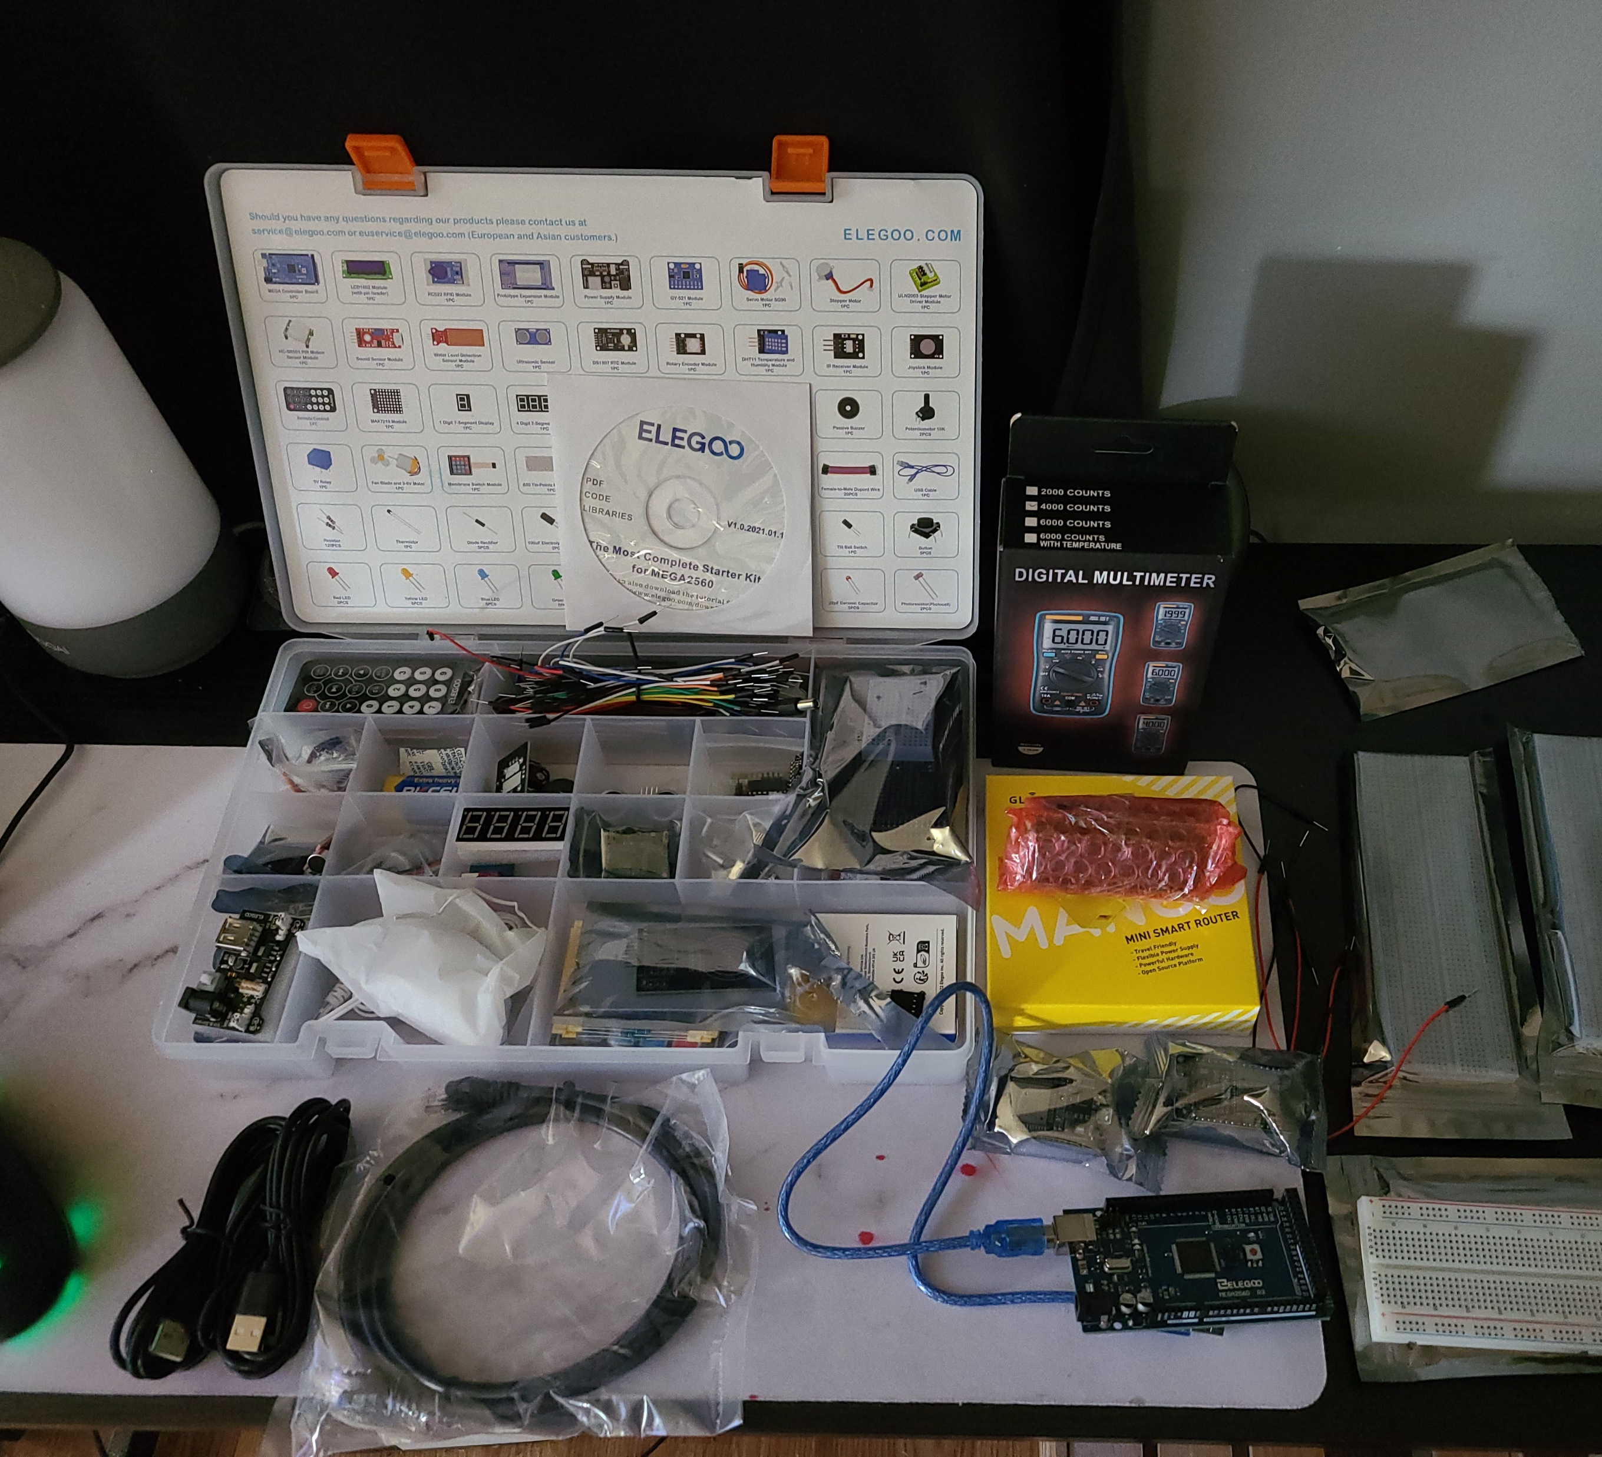
Inventory of IoT Kit (picture)
UCTRONICS Kit
ESP32 (2)
LCD Modules (2)
Breadboards (3)
Mini Router
Patch Cable
Digital Multi Meter
USB to Micro USB (2)

Slide 8
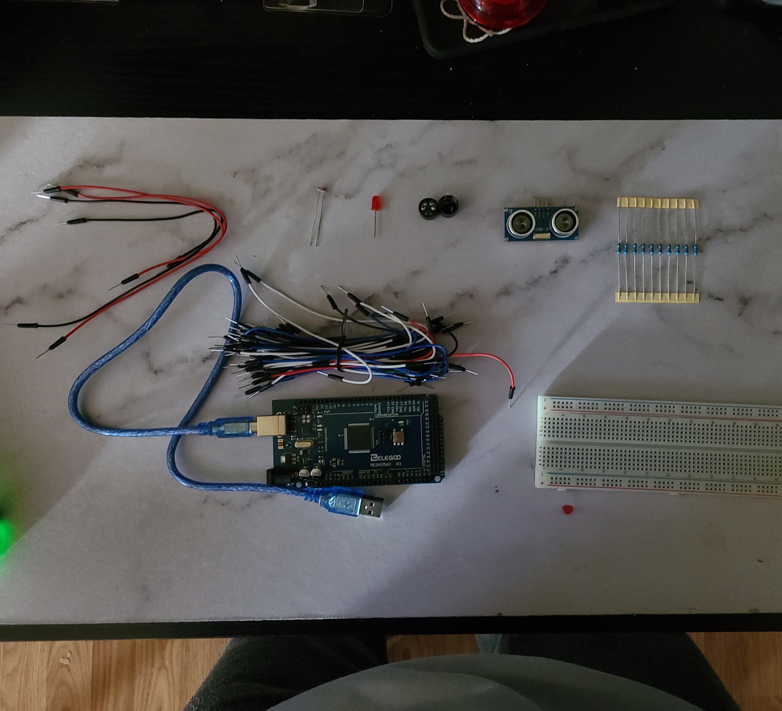
Organization of Project Components (picture)
Arduino Mega 2560
Breadboard
Resistor 10kΩ
LEDs
Ultrasonic Sensor
Active Buzzer
Photoresistor
Wires
USB Type B cable

Slide 9
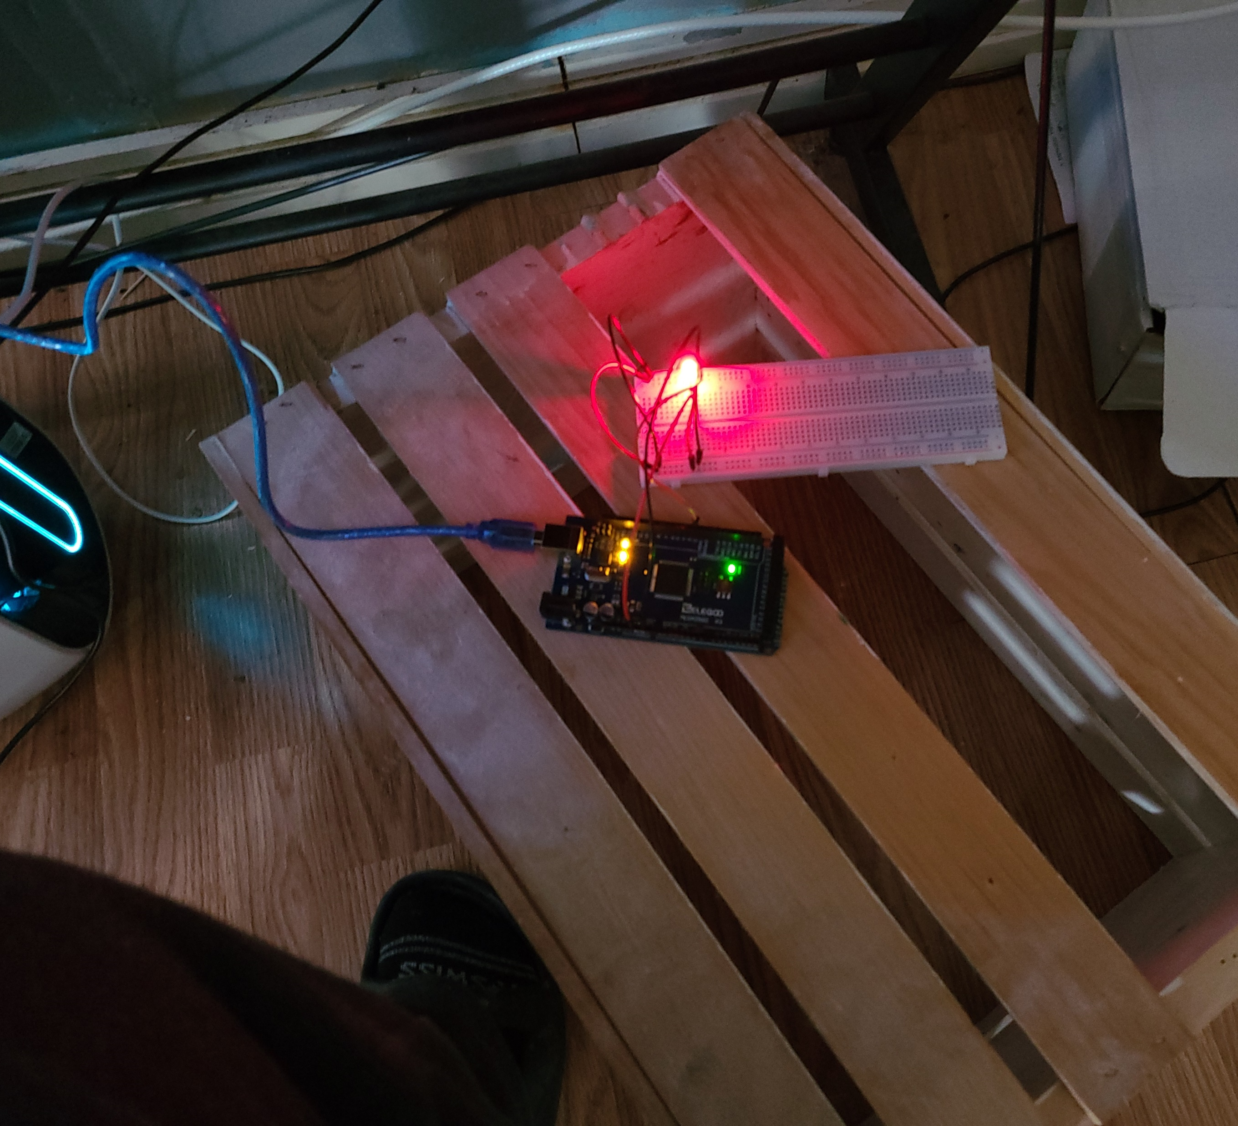
Circuit with red LED on (picture)

Slide 10
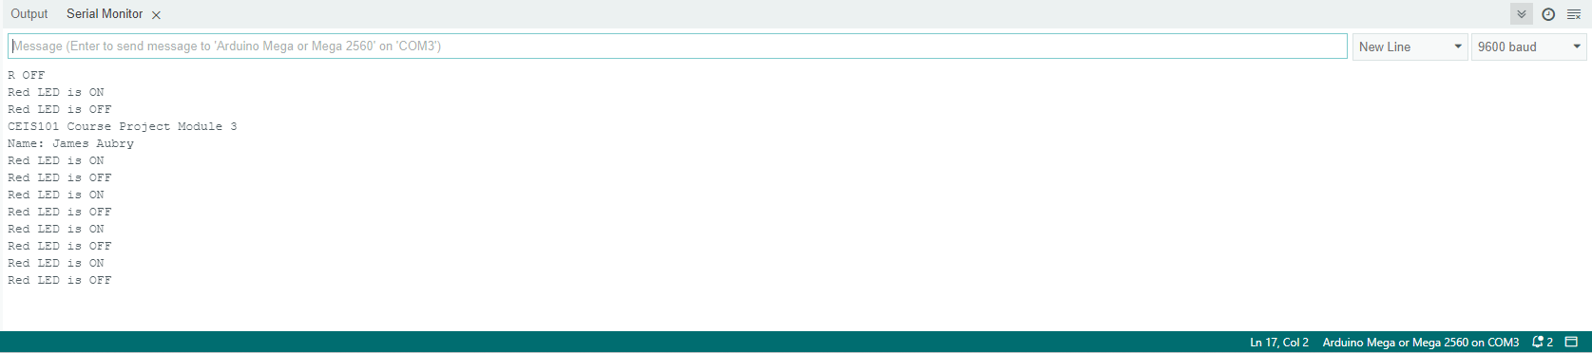
Serial Monitor (screenshot)

Slide 11
CEIS101
Module 4
Adding Door Sensor to Smart Home System
Student: James Aubry

Slide 12
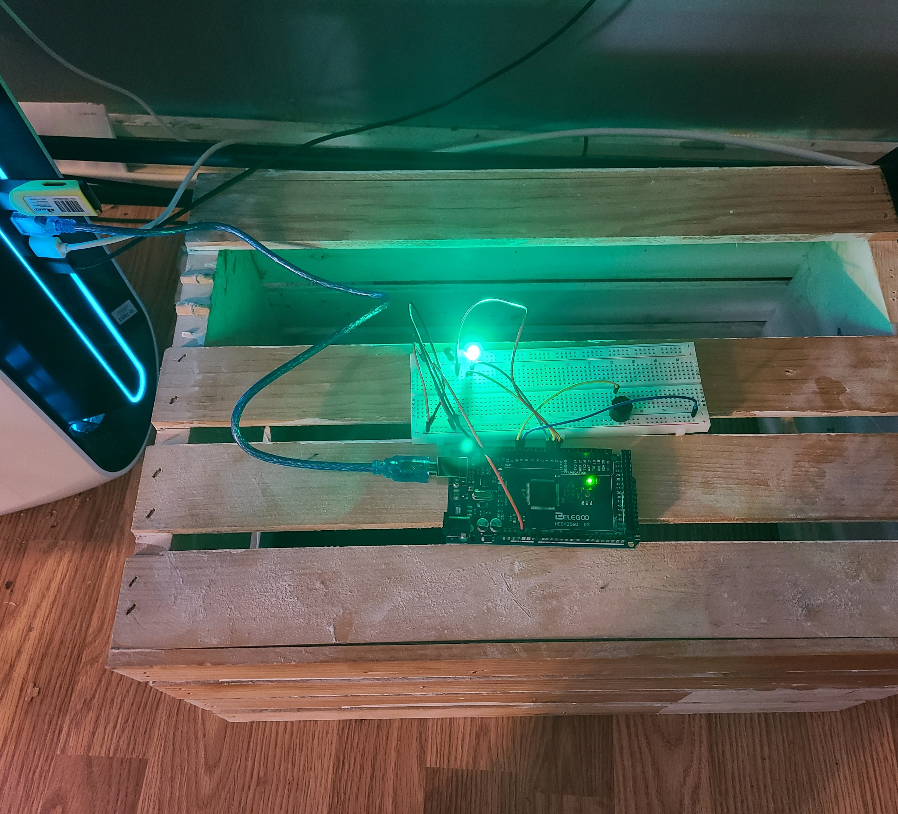
Circuit of door closed with Green LED ON (picture)

Slide 13
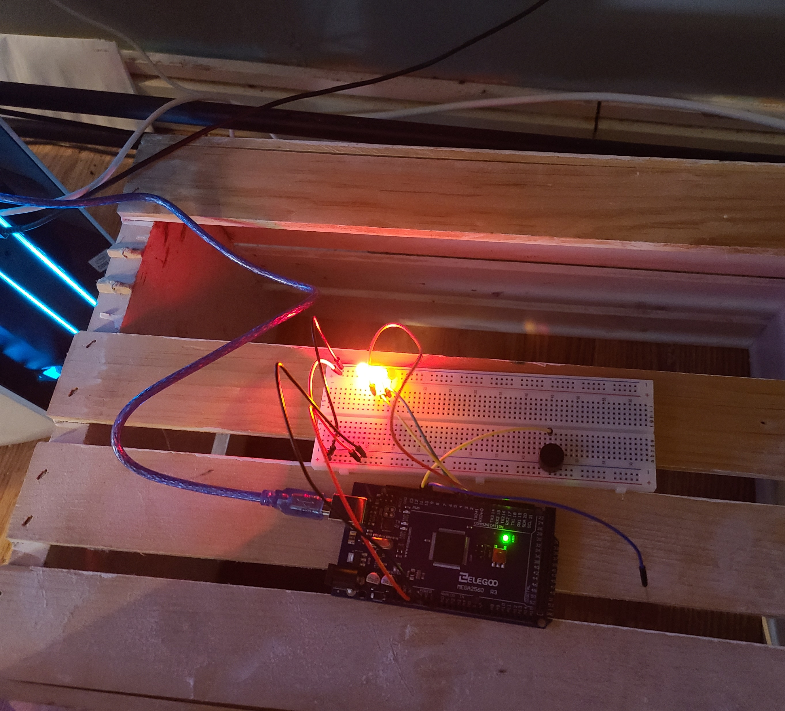
Circuit of door open with Green LED OFF (picture)

Slide 14
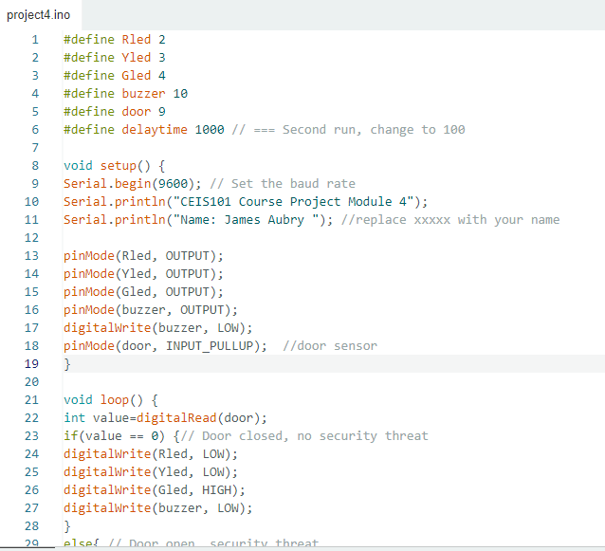
Arduino Code (screenshot)

Slide 15
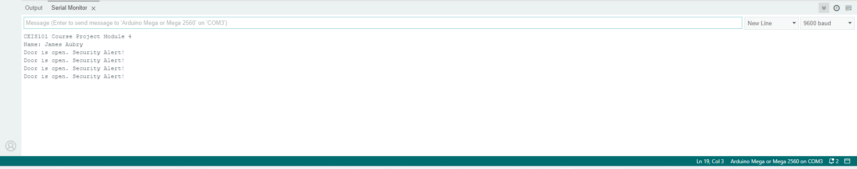
Serial Monitor (screenshot)

Slide 16
CEIS101
Module 5
Adding Distance Sensor to Smart Home System
and Conducting Data Analysis
Student: James Aubry

Slide 17
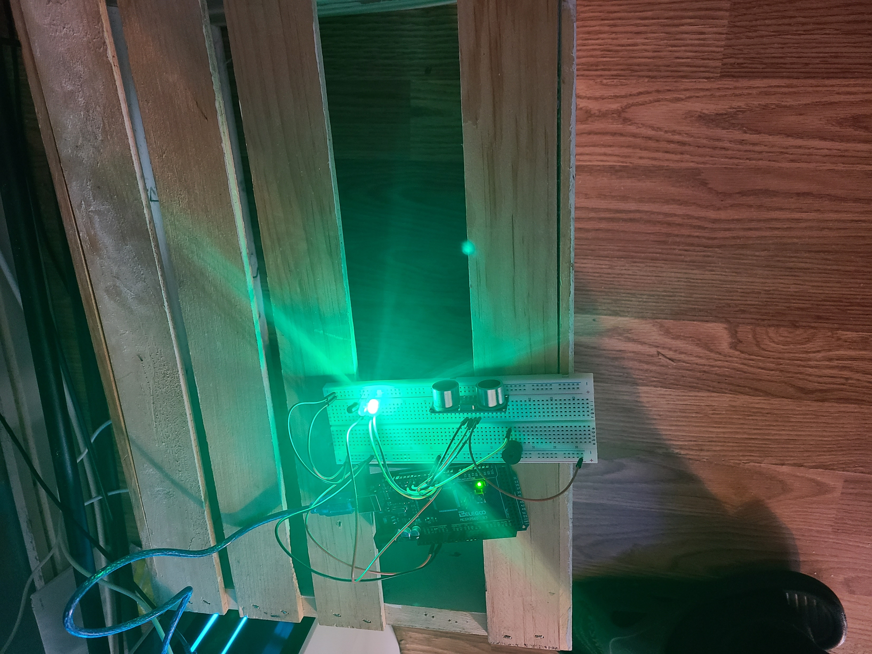
Circuit with green LED on (picture)

Slide 18
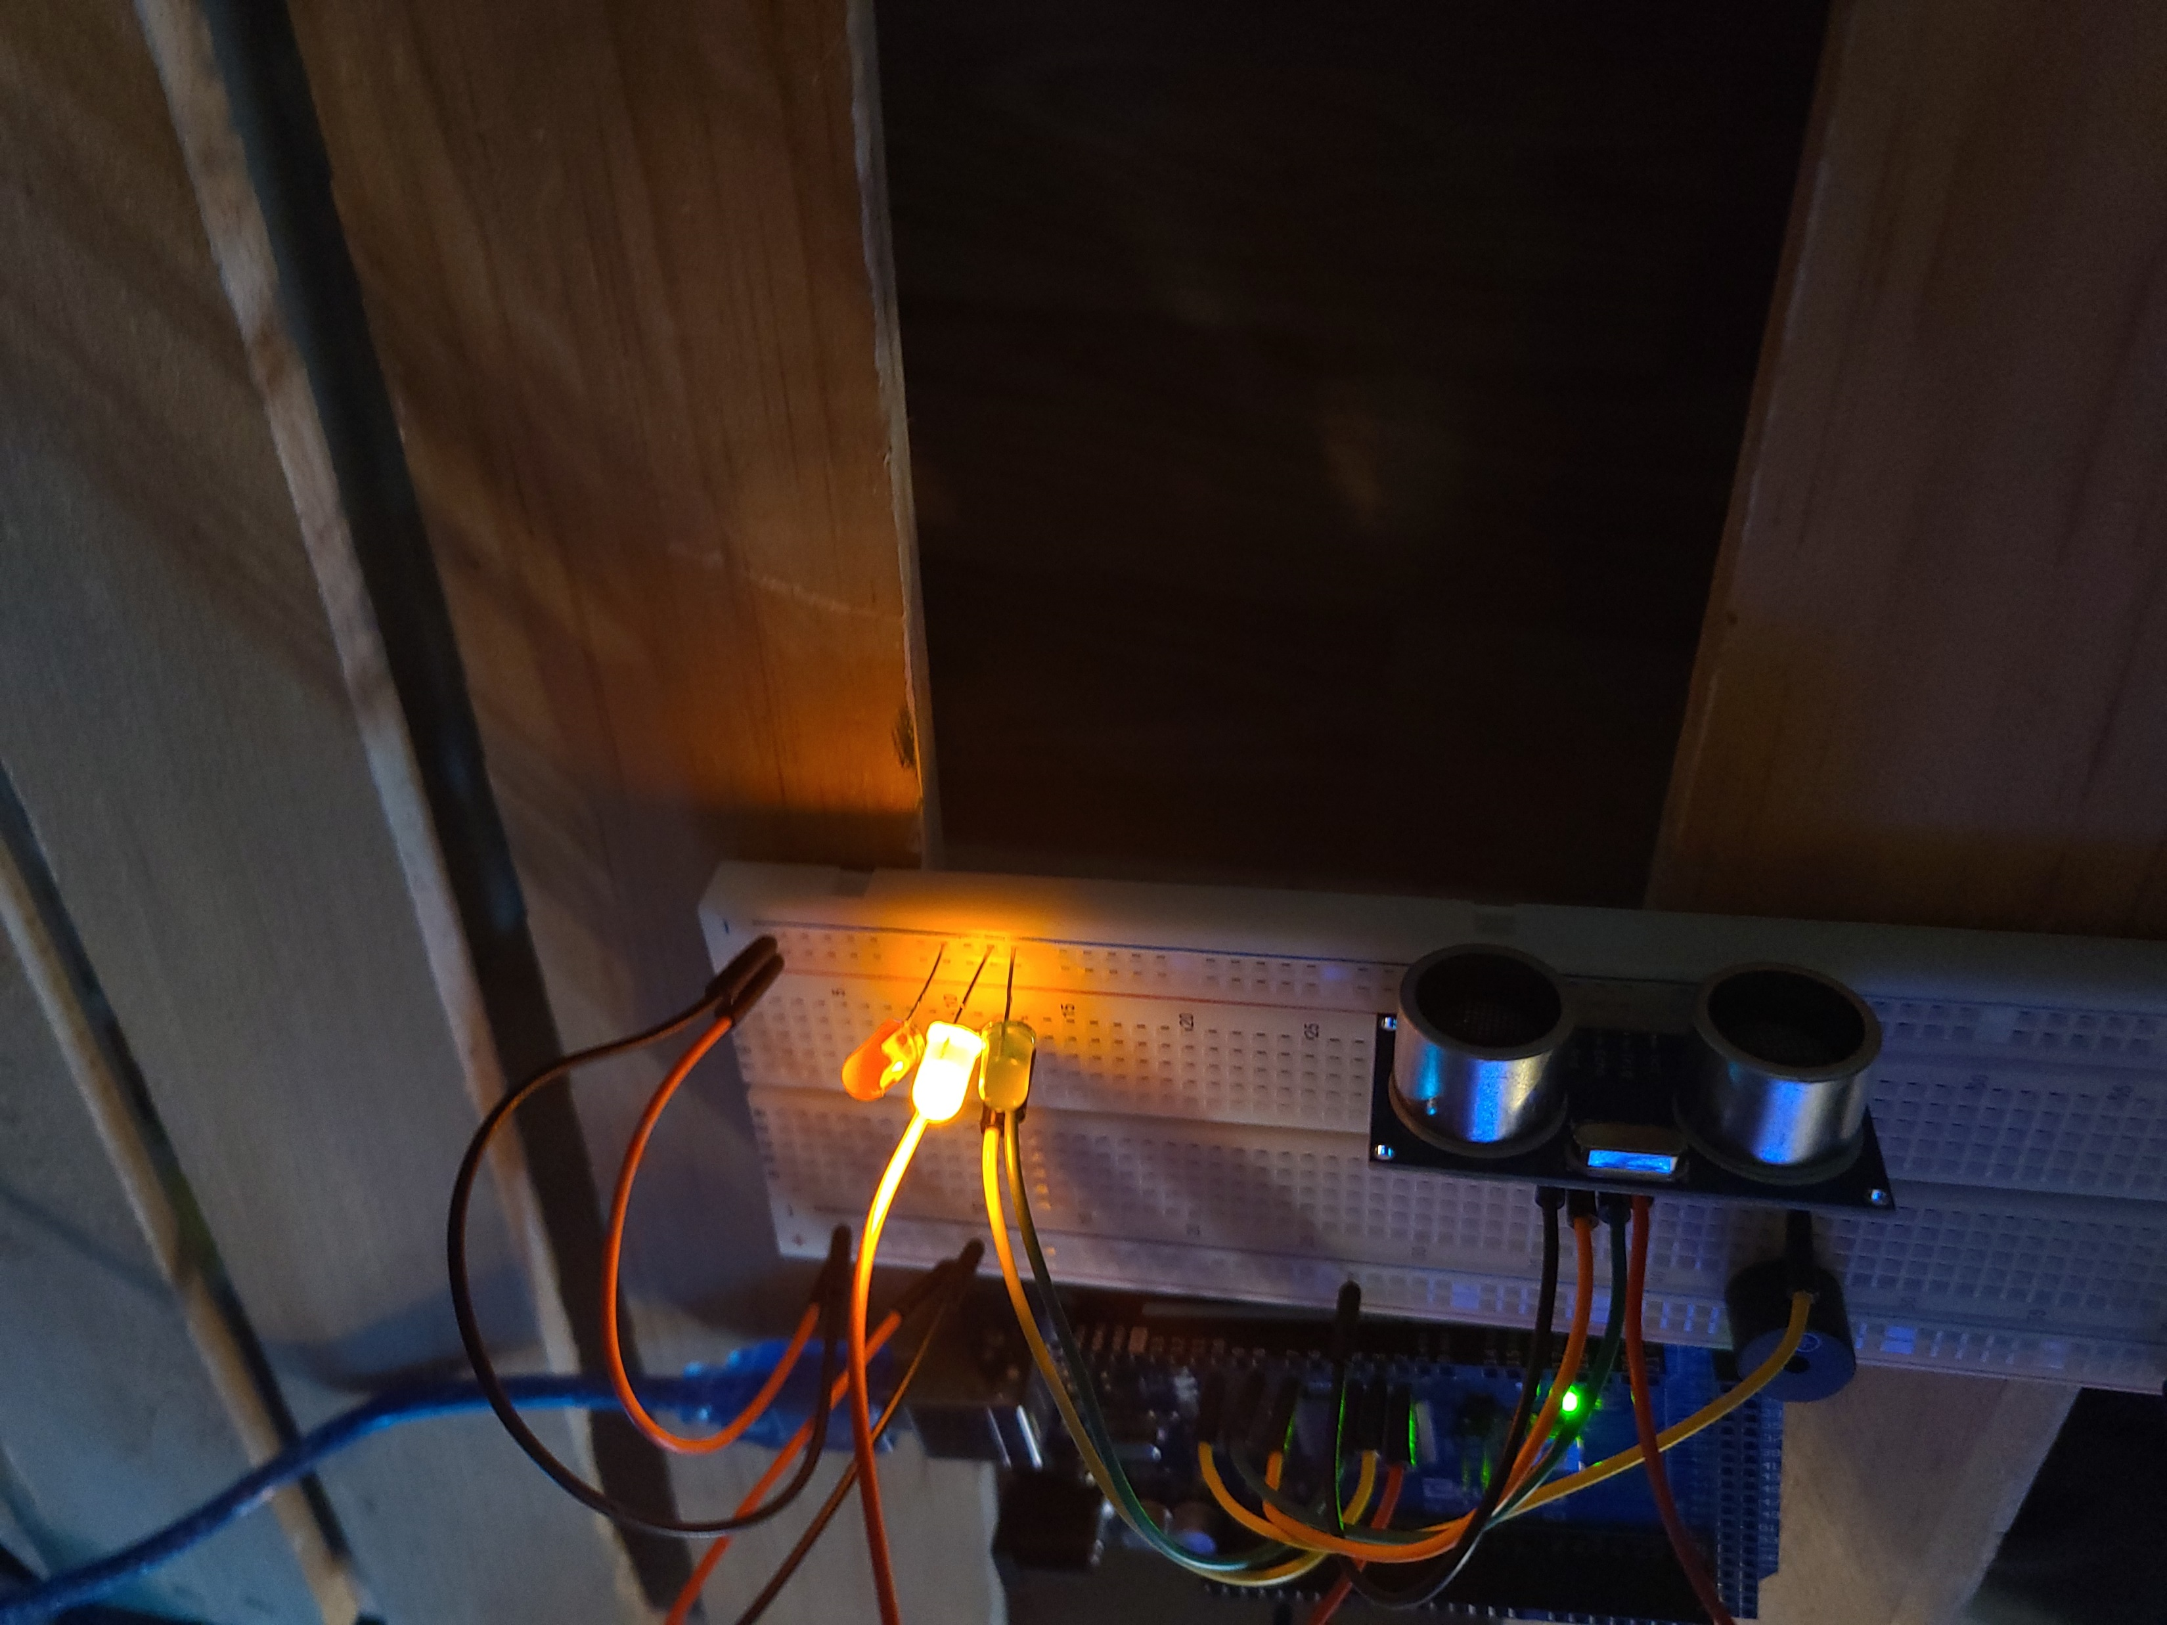
Circuit with yellow LED on (picture)

Slide 19
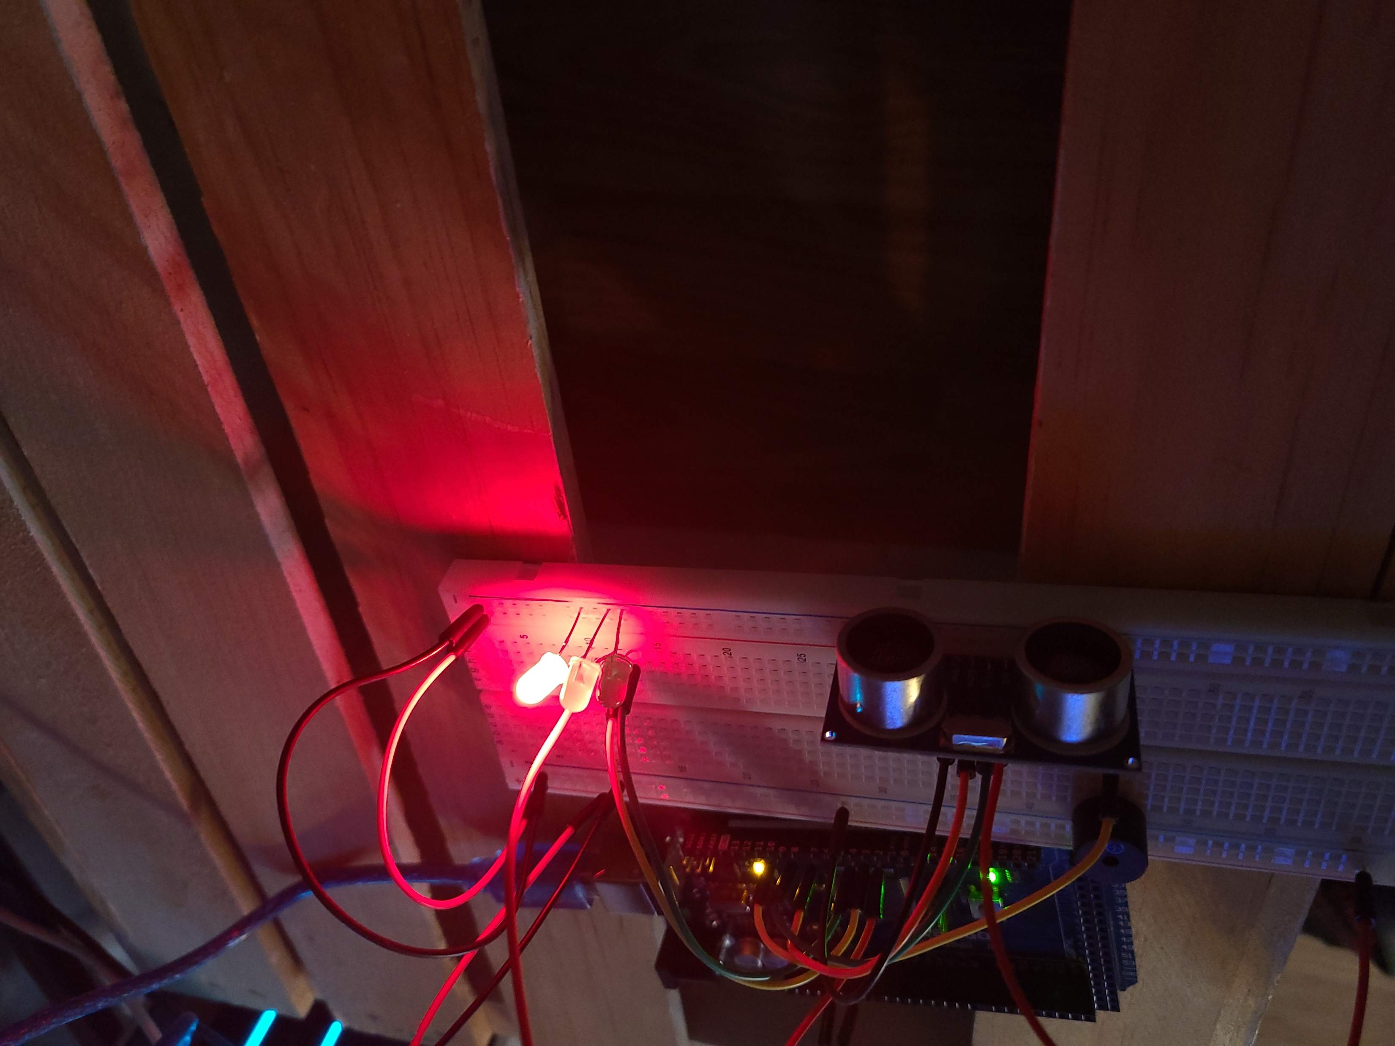
Circuit with red LED on (picture)

Slide 20
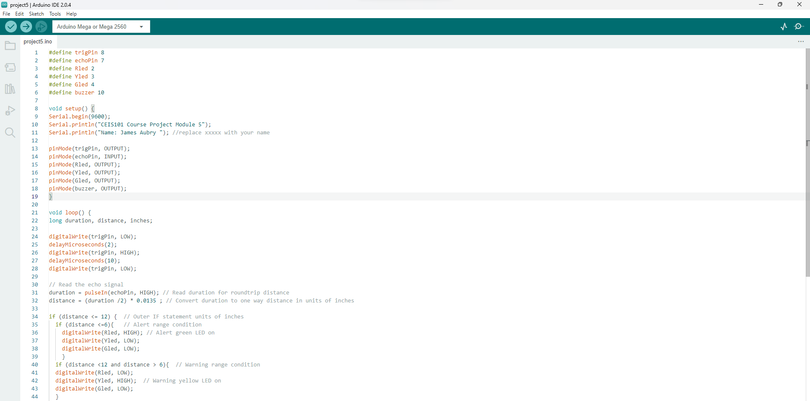
Arduino Code (screenshot)

Slide 21
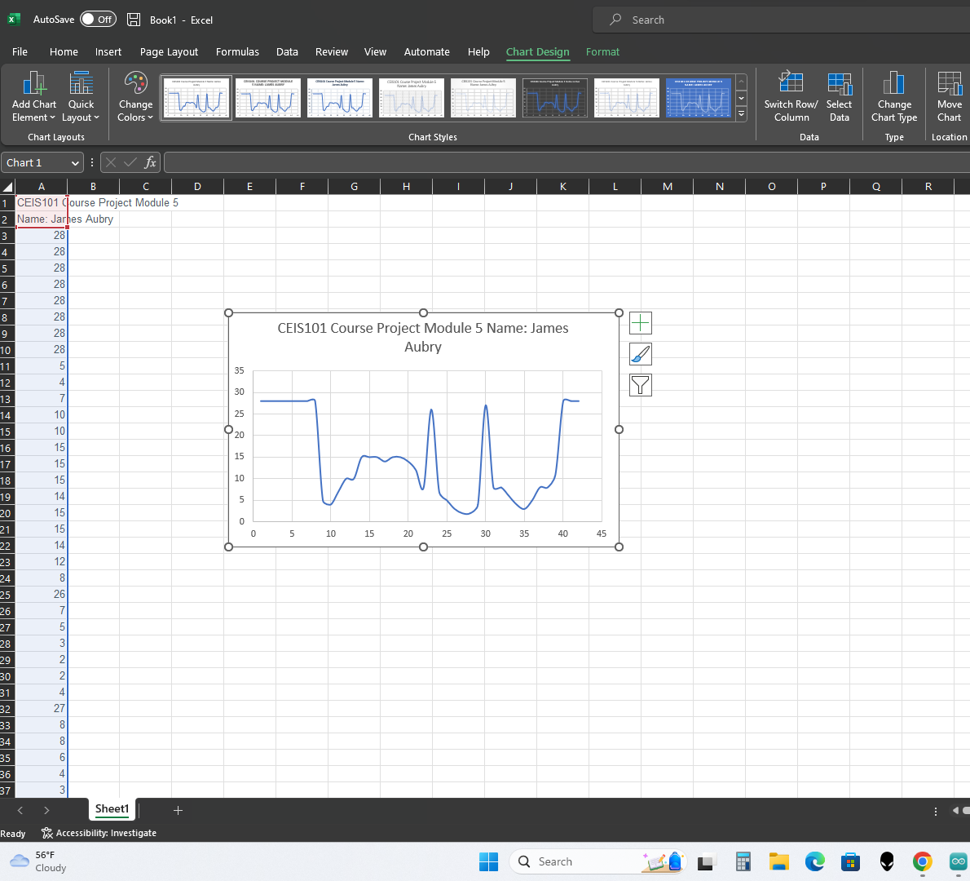
Plot of data (graph from Excel)

Slide 22
CEIS101
Module 6
Adding Automated Light to Smart Home System
Student: James Aubry

Slide 23
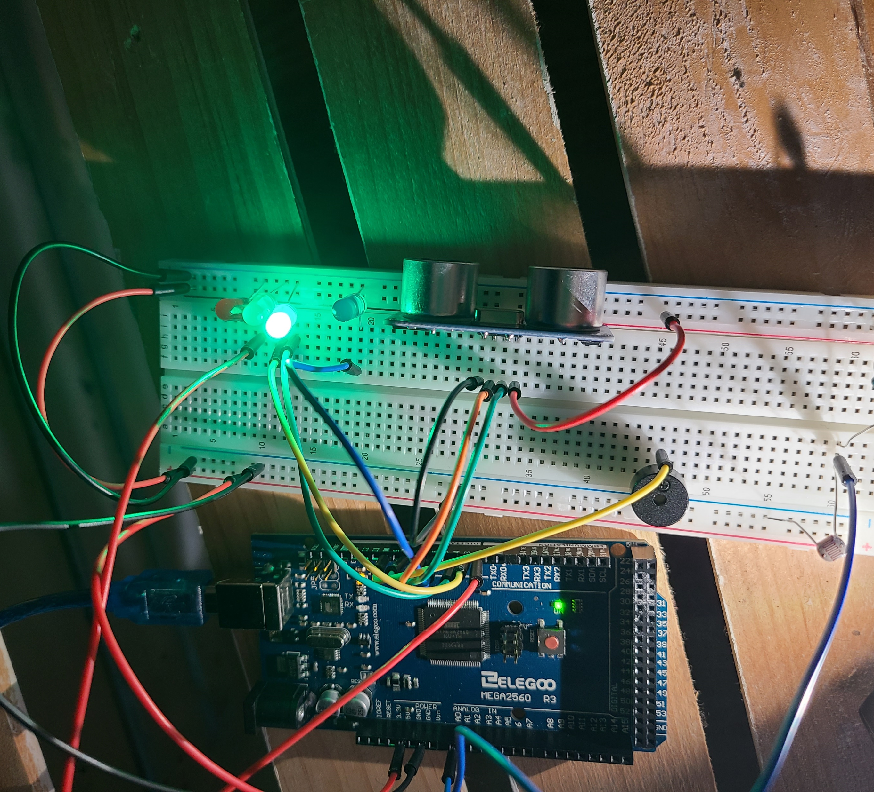
Circuit with automated (blue) LED off (picture)

Slide 24
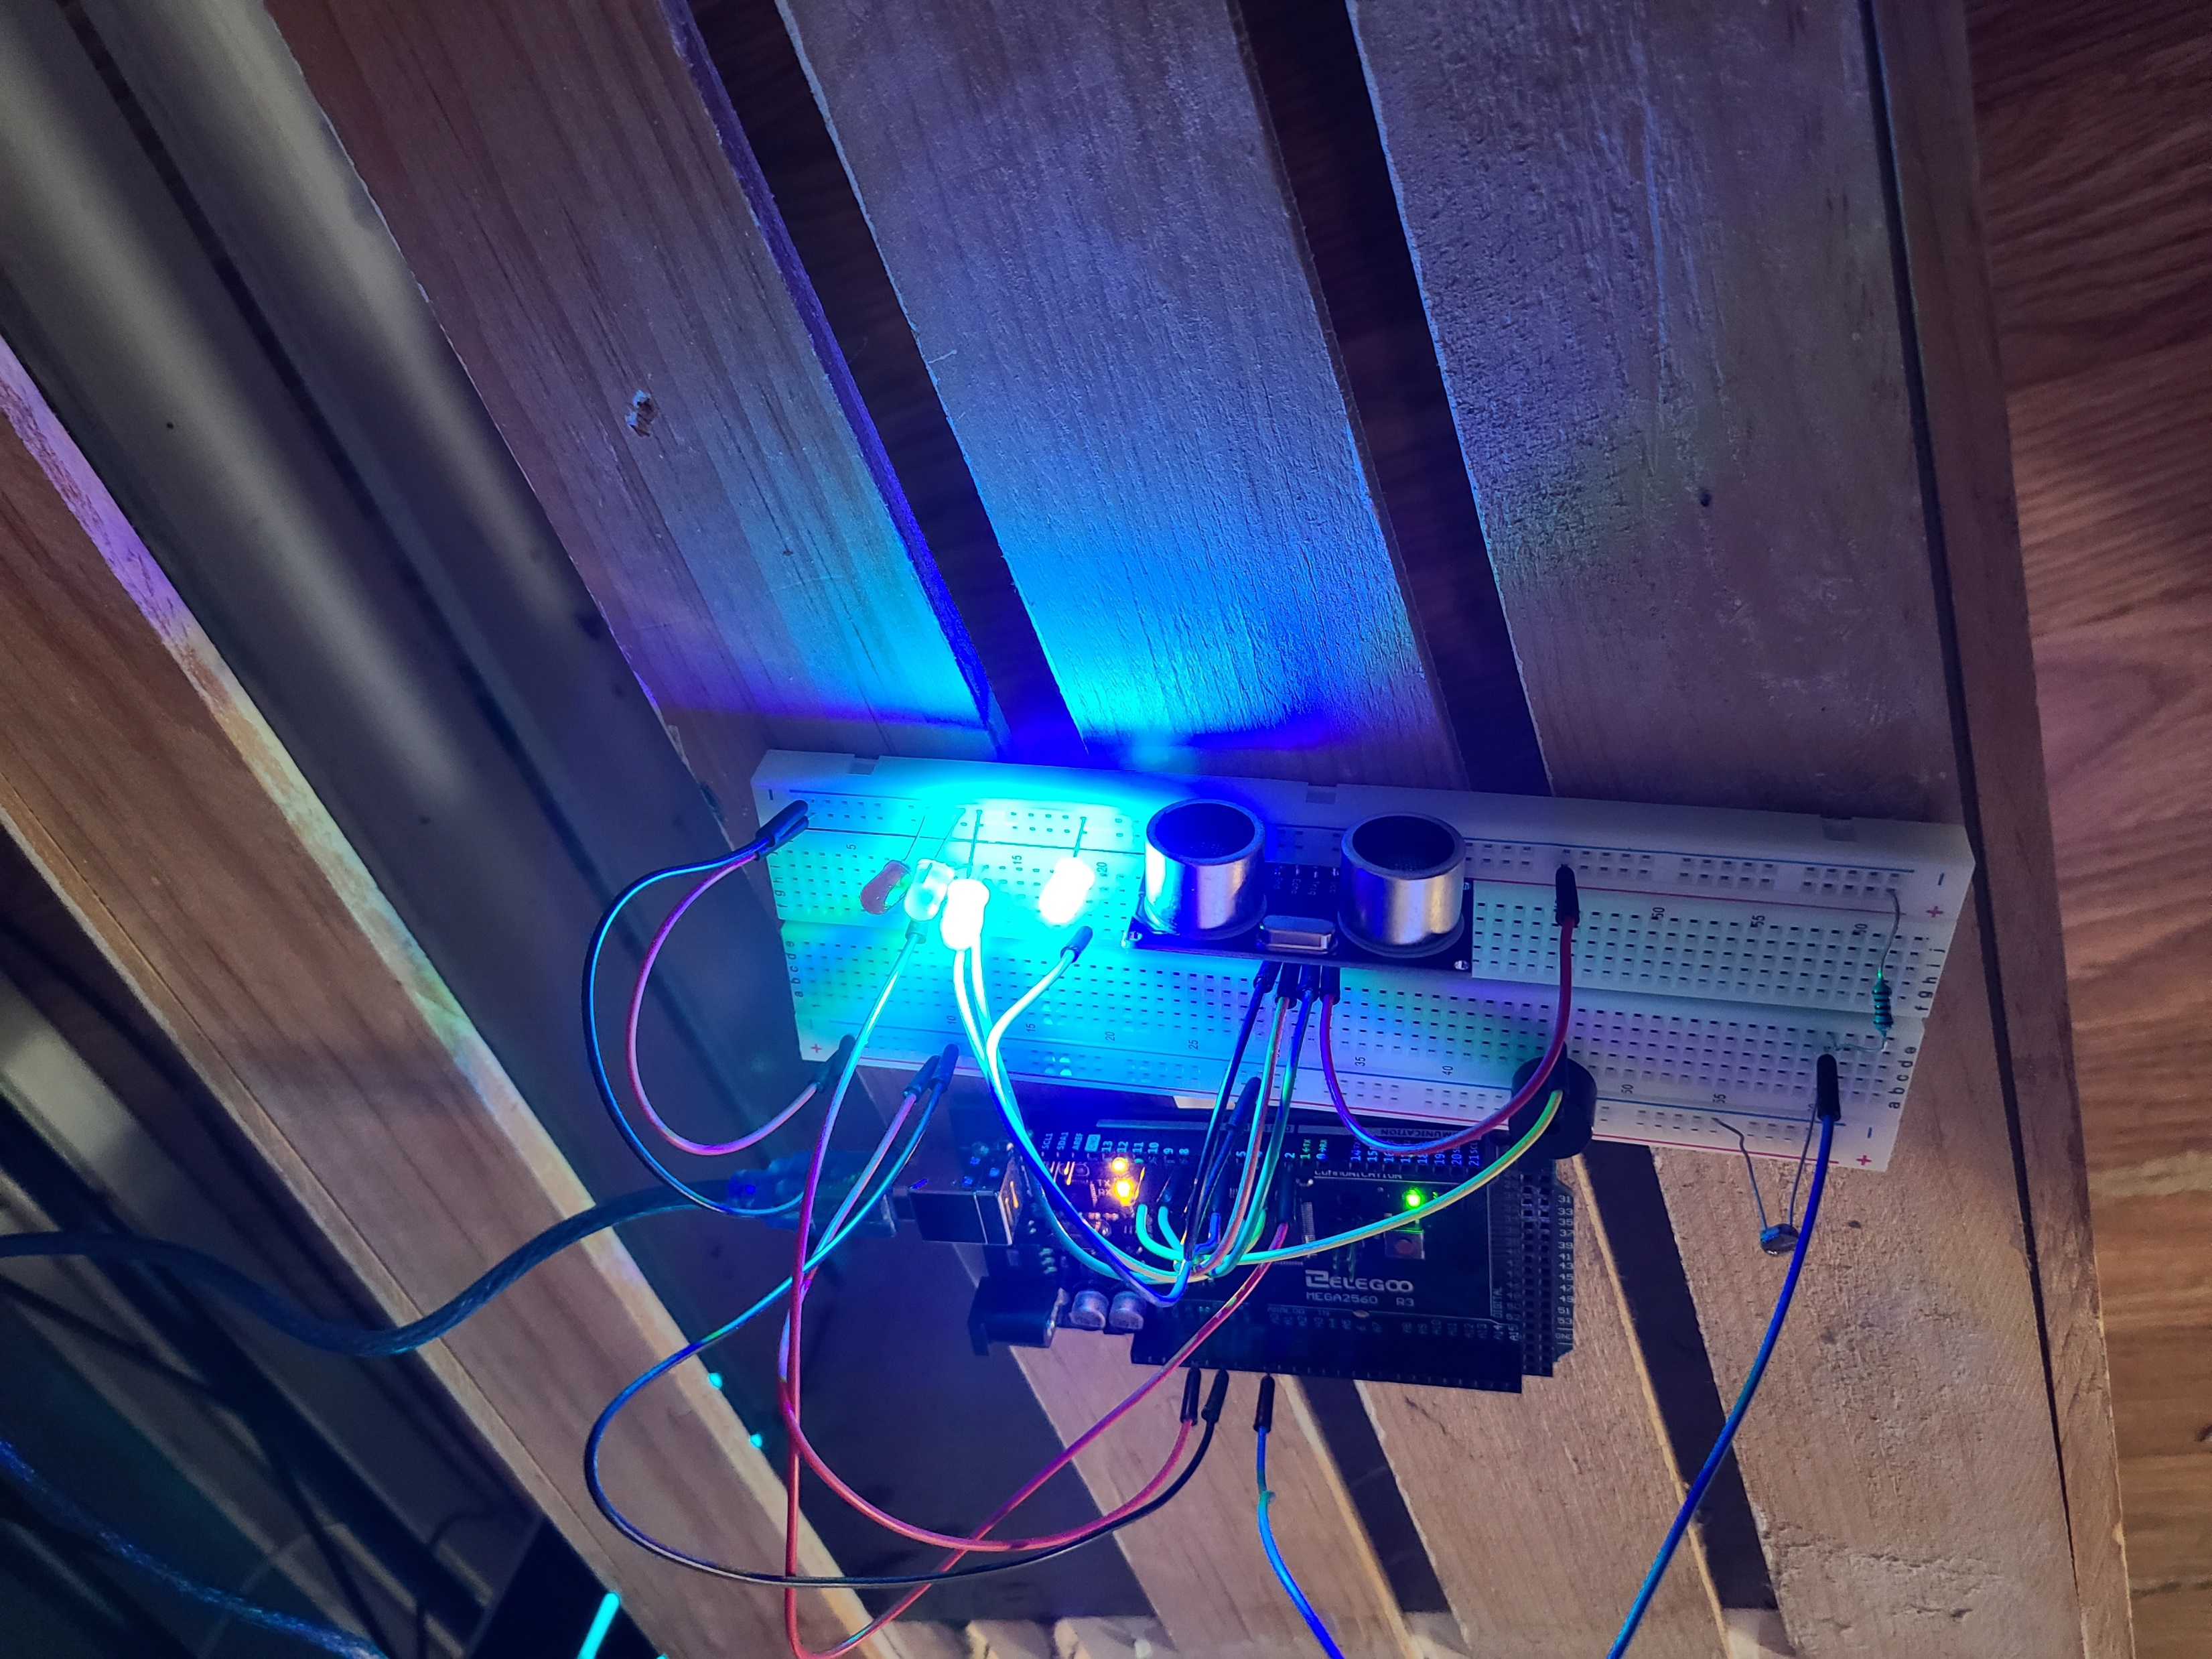
Circuit with automated LED on (picture)

Slide 25
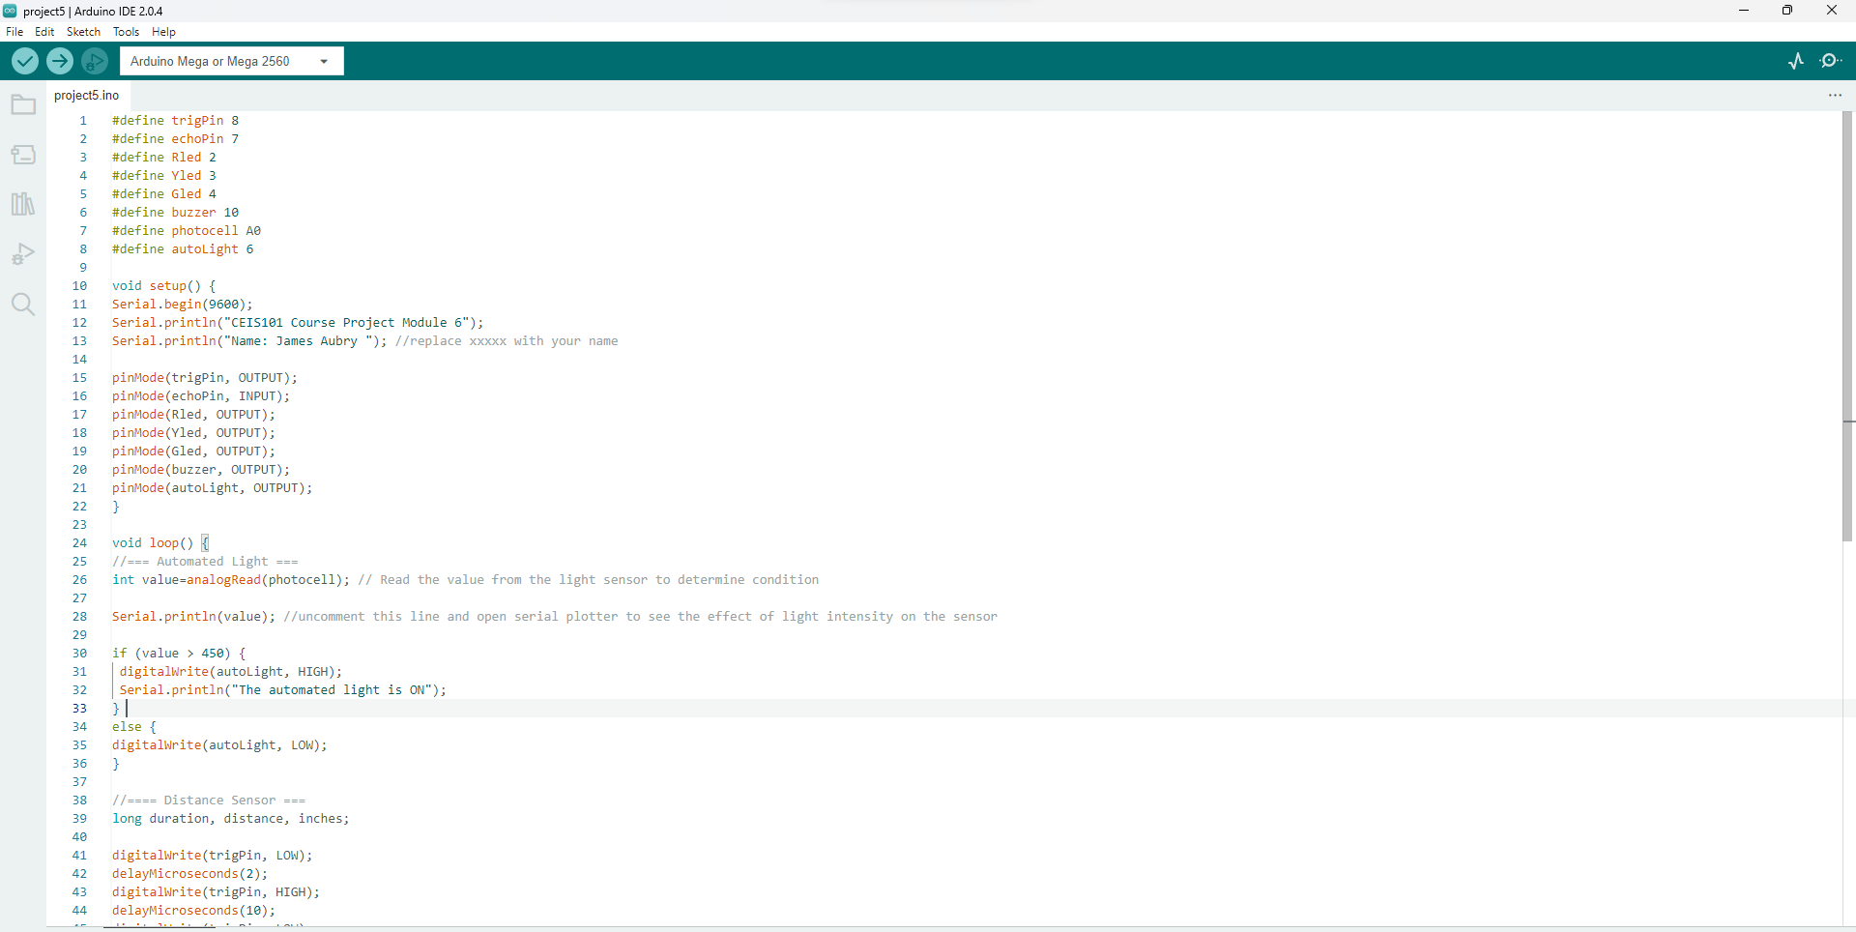
Arduino Code (screenshot)

Slide 26
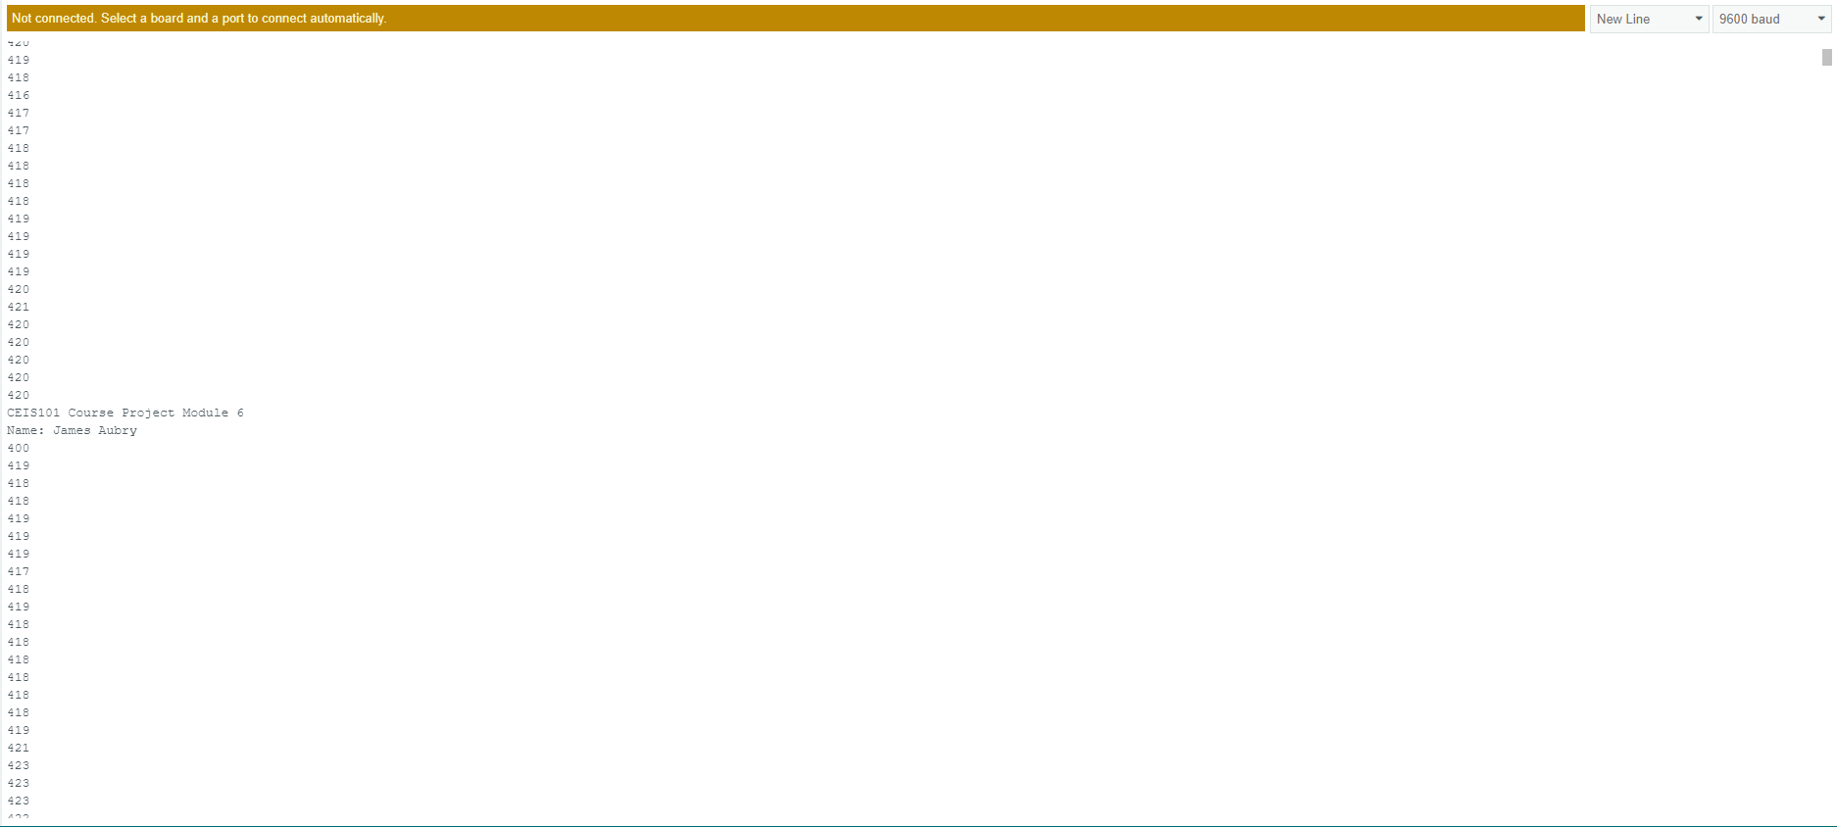
Serial Monitor (screenshot)

Slide 27
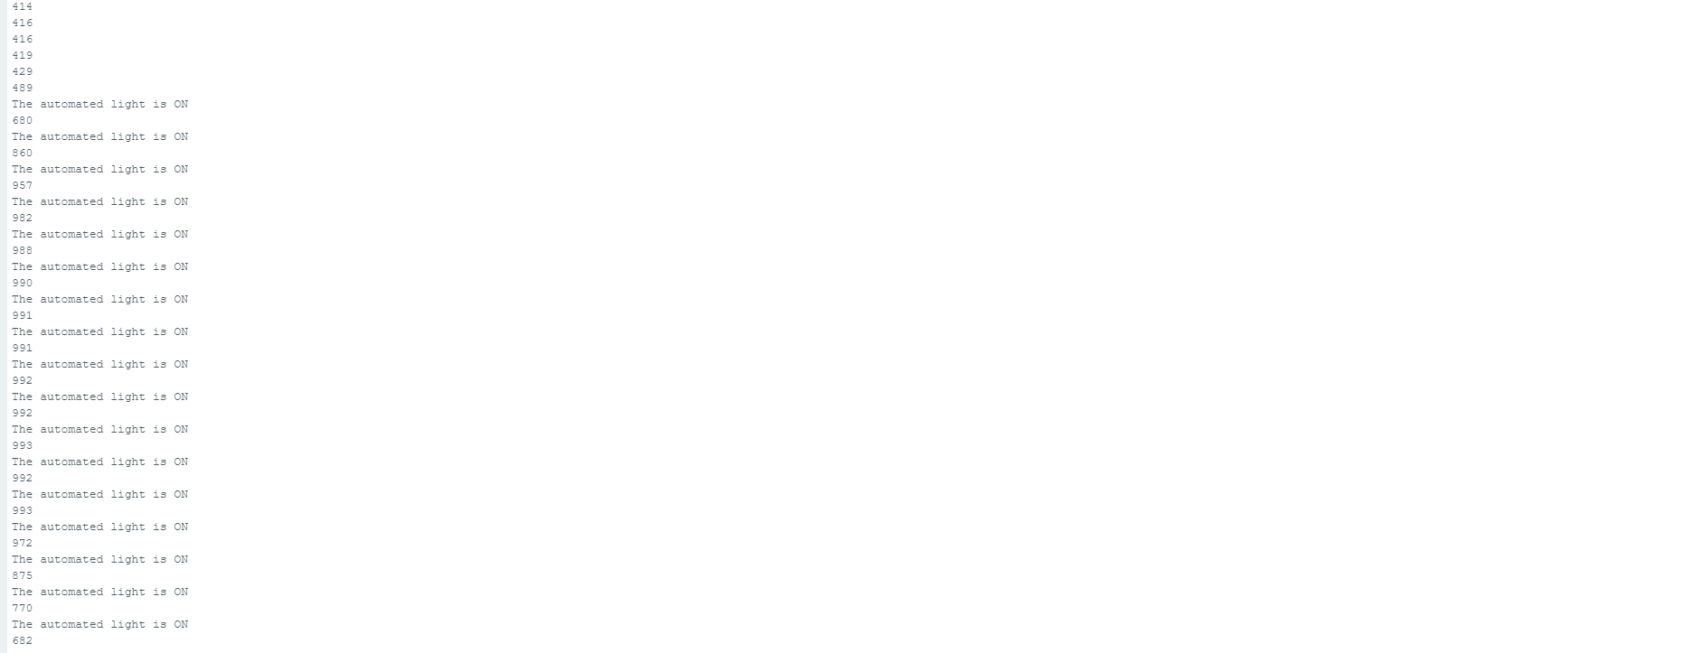
Serial Monitor (screenshot)

Slide 28
CHALLENGES
Some challenges I ran across
- for the photo sensor my room was too dark so there for the automated light was staying on the whole time I had to hold a flashlight to the sensor.
- at one point the code didn’t run right due to not having the whole code copied
- my ground was not connected completely a few times causing no power had to make sure ground was secure

Slide 29
CAREER SKILLS ACQUIRED
-Hardware/device knowledge
-Networking/connectivity ability
-coding/programming
- understanding of I.O.T

Slide 30
CONCLUSION
This project was an amazing introduction to the course
Have a good understanding of the internet of things and the process of coding and programming
Learned a good bit about the Arduino board also along with installing sensors etc

